Slide 1
A survey of consumer preferences for midwifery care, place of birth and normal birth, prior to pregnancy in eight high-income countries.
April 2018

Slide 2
International study
Notes:
Forward backward translation
Sampling frame

Slide 3
International team- Country Leads
Wendy Hall, School of Nursing, UBC
Yvonne Hauck, School of Nursing, Midwifery and Paramedicine, Curtin University and King Edward Memorial Hospital, Perth, Western Australia, Australia.
Joyce Edmonds, Connell School of Nursing, Boston College, Maloney Hall, 140 Commonwealth Avenue, Chestnut Hill, MA 02467, USA. joyce.edmonds@bc.edu
Michelle Sadler, Department of History and Social Sciences, Faculty of Liberal Arts, Adolfo Ibáñez University, Diagonal Las Torres 2640, Peñalolén, Santiago, Chile. michelle.sadler@uai.cl
Soo Downe & Gill Thomson, School of Community Health and Midwifery, University of Central Lancashire, Preston, Lancashire, UK, PR1 2HE. SDowne@uclan.ac.uk , GThomson@uclan.ac.uk
Judith McAra- Couper & Debrah Payne, Centre for Midwifery & Women's Health Research, Faculty of Health & Environmental Sciences, Auckland University of Technology, Private Bag 92006, Auckland 1142. judith.mcara@aut.ac.nz
Emma Swift, Midwife at Björkin Ljósmæður, PhD student, Department of Midwifery, Faculty of Nursing - University of Iceland, emma.marie.swift@gmail.com
Anne Mallott, Midwifery Education Program, McMaster University, 1280 Main St. West, MDCL 2nd Floor, Hamilton, Ontario, Canada. malotta@mcmaster.ca
Mechthild Gross & Joanna Steffing, Midwifery Research and Education Unit, Hannover Medical School Carl-Neuberg-Str. 1, 30625 Hannover, Germany, Joana.Streffing@gmx.de, Gross.Mechthild@mh-hannover.de

Slide 4
normal birth and midwifery care
Notes:
The next generation might not want the type of birth that maternity care organizations are recommending. Normal deliveries and if possible, midwifery care, is recommended for most women but do young men and women want this ? If not, educational interventions might be necessary, to promote the health benefits of normal birth and midwifery care.

Slide 5
North American Research: UBC study 2006; Boston College 2014
Notes:
I have been involved in a couple of country specific studies on the birth attitudes of young men and women; 2006 Canadian survey
2014 US survey. In the next few minutes I will show you some of the highlights from these two surveys.

Slide 6
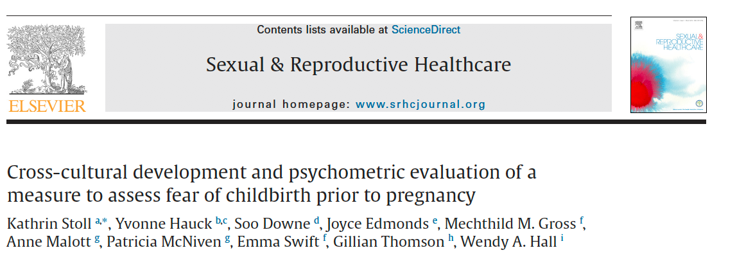
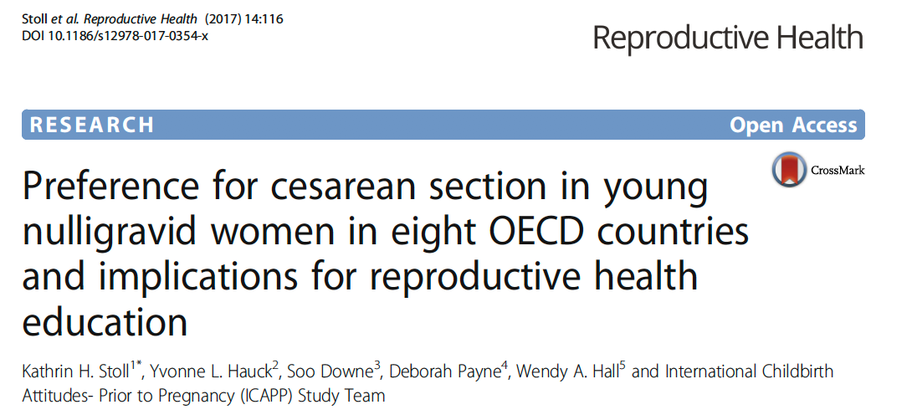
COLLABORATIVE DEVELOPMENT of Data ANALYSIS PLAN
Data Analysis plan was developed collaboratively, with input from all team members
I analyzed all data points and created a series of audio slides, to share results with team members
Each team members was asked to identify priority areas and areas of interest
A list of 8 areas was identified, and team members were asked to indicate their interest in collaborating on a manuscript in each area
As the analysis evolved, some areas/manuscripts were grouped together
Most country leads published country specific results, usually with statistical support from PI
Notes:
End Result: Our team drafted four manuscripts based on the cross-country dataset, two have been published, and two are under review.
First paper- Survey and scale development
Second Paper had a focus on preferences for cesarean section in a hypothetical healthy pregnancy. i.e. how many students in each country would prefer CS without medical indication and why
Third paper -A cross-country analysis of attitudes toward childbirth technologies and interventions among young people.
Fourth paper – Still under review and is the focus of this presentation

Slide 7
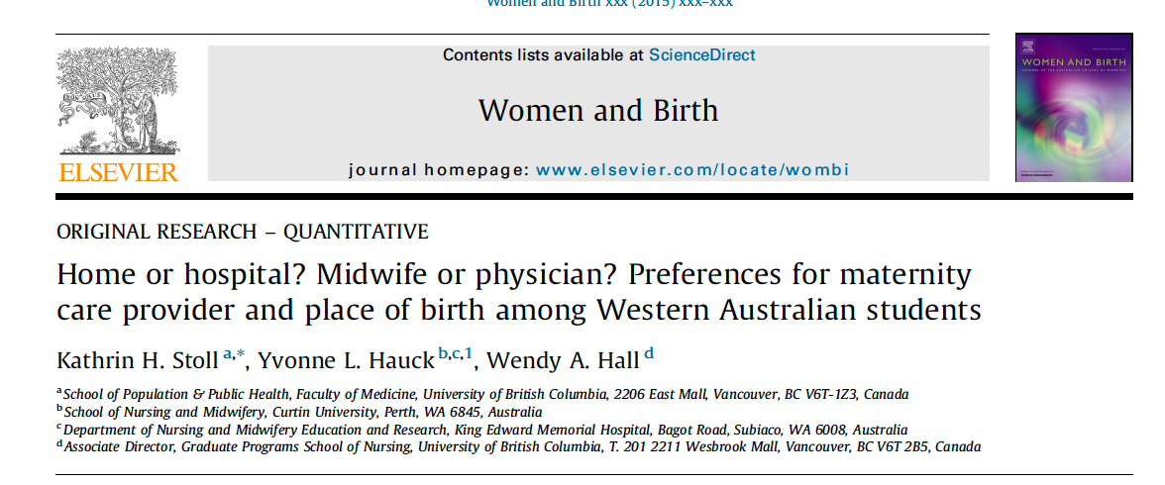
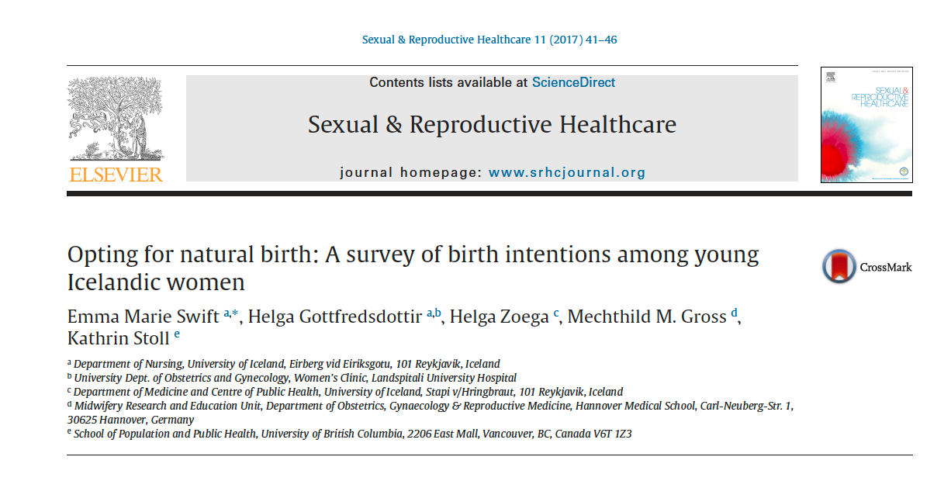
research questions
How many students in each country prefer midwifery-led care, out of hospital birth options, vaginal birth and vaginal birth without epidural? Do childbirth preferences vary by gender?
Are preferences for midwifery-led care, home birth and vaginal birth in our sample related to national rates?
Notes:
Examining the degree of commonalities and differences in young adults’ childbirth preferences between countries can help us understand how these preferences might emerge and lay the foundation for developing strategies that increase the demand for normal childbirth and midwifery-led care across birth settings.

Slide 8
Exclusion criteria
 | Total | Australia | NZ | UK | USA | Canada | Chile | Germany | Iceland
Started surveys | 6571 | 1053 | 559 | 482 | 618 | 326 | 1056 | 1305 | 1172
Have one or more children | 670 (10.7) | 126 (12.2) | 29 (5.3) | 56 (12.1) | 3 (0.5) | 12 (3.8) | 95 (9.3) | 119 (9.3) | 230 (23.4)
Do not want children | 639 (10.7) | 137 (13.3) | 65 (11.9) | 54 (11.9) | 36 (6.0) | 26 (8.3) | 112 (10.9) | 162 (12.7) | 47 (6.2)
Fear of birth is a reason* | 126 (27.7) | 25 (28.7) | 20 (35.1) | 12 (44.4) | 13 (31.7) | 7 (30.4) | 7 (23.3) | 34 (22.4) | 8 (21.1)
Pregnant at time of data collection | 152 (3.0) | 18 (2.3) | 4 (0.9) | 6 (1.6) | 1 (0.2) | 4 (1.5) | 26 (3.2) | 37 (3.1) | 56 (8.2)
* Denominator = participants who reported not wanting children and who answered this optional question. All but one of the 126 students reported not having any children.
We excluded participants who missed one or more eligibility question and/or
Had one or more children: 670
Did not want children: 639
Were older than 40: 101
Were pregnant: 152
Did not complete the mode of birth preference question: 190
n= 4569
Notes:
Noteworthy: Lots of students in Iceland who are already parents (1 in 4) and quite a few pregnant students (8%).
Fear of birth is a reason for not wanting children that is reported by close to 30% of students. Fewer students in Iceland and Germany reported FOB as a reason for not wanting children. In the UK, 44% reported it as a reason.

Slide 9
SAMPLE CHARACTERISTICS
 | Total | Australia | NZ | UK | USA | Canada | Chile | Germany | Iceland
n (%) Female * | 3729 (78.6) | 577 (75.1) | 370 (83.9) | 320 (89.4) | 389 (74.1) | 206 (76.6) | 484 (62.6) | 854 (86.6) | 520 (84.8)
n (%) Born in survey country | 3964 (83.3) | 530 (67.3) | 272 (61.4) | 319 (89.1) | 479 (88.5) | 211 (78.4) | 666 (86.2) | 936 (94.8) | 561 (91.2)
Mean Age | 23 | 22 | 22 | 23 | 20 | 23 | 28 | 23 | 23
Notes:
To minimize bias from socio-demographic differences between country samples, we used a standardized cohort of women between the ages of 18-25, who were born in the survey country, and were enrolled in a field of study other than health sciences, to facilitate comparisons across countries.

Slide 10
Description of key indicators
Preference for midwifery-led care: Respondents were asked to choose which care provider they would want to provide care during pregnancy and birth, assuming that they (their partner) have no health problems and will not experience complications during pregnancy. Options included: Midwife, General Practitioner (GP), Obstetrician/Gynecologist, I don’t know and Other. The GP option was only included in countries where GPs offer intrapartum care (e.g. Canada and Australia). Each type of care provider was briefly defined, and definitions reflected the scope of practice for each care provider within each country. For instance, in countries where midwives attend births in different settings, this was included in the definition.
Preference for out-of-hospital birth options: Respondents were asked to choose where they would prefer to give birth. Response options for place of birth preferences varied by country, depending on the organization of maternity care in the country. All countries included the options ‘at home, with a midwife’, ‘a birthing center’ (defined as an out-of-hospital birthing facility, staffed by midwives; a more home like environment than a hospital ward), regardless of whether these options were available in the country. We included home and birthing centers as options in each country, to assess consumer demand for out-of-hospital birth.

Slide 11
Description of key indicators
Preference for normal birth: Respondents were asked about their preferred mode of delivery in a health pregnancy and about their preference for managing labor pain. Students who preferred a vaginal delivery and who answered no to the question ‘Would an epidural (freezing/numbing from the waist down by injection of anaesthetic into the back) to help you (your partner) manage labour pain be your preference? ’ were grouped together, to create a group who had normal birth intentions.
There are debates about the terminology used for such an outcome. This has included ‘normal’, ‘natural’, ‘uncomplicated’, ‘optimal’, ‘physiological’, and ‘vaginal’ birth. For this study we chose the term normal birth, because consumer and maternity care organizations in the UK have used this term to describe "a physiological birth where the baby is delivered vaginally following a labour which has not been altered by technological interventions"[42,43].

Slide 12
PREFERENCES FOR MIDWIFERY CARE

Slide 13
Preferences for midwifery-led care
 | Total n (%) | Australia n (%) | Canada n (%) | Chile n (%) | England n (%) | Germany n (%) | Iceland n (%) | NZ n (%) | USA n (%)
Full Sample (n=4568) | 2203 (48.2) | 267 (35.9) | 77 (29.4) | 431 (55.8) | 272 (78.2) | 476 (48.5) | 402 (71.9) | 232 (56.4) | 46 (9.4)
Standard Cohort* (n=1390) | 644 (46.3) | 55 (37.4) | 13 (17.3) | 73 (67.0) | 79 (78.2) | 262 (52.7) | 72 (78.3) | 73 (61.9) | 17 (6.8)
* The standard cohort is defined as women who were born in the survey country, were not health sciences students and were between the ages of 18-25
Notes:
Overall, 2203 students (48.2 %) preferred a midwife. Preference for a midwife for the standardized cohort varied by country from 6.8 % in the United States to 78 % in England and Iceland.

Slide 14
Preferences for midwives related to national rates of MW attended births
Notes:
In both the full sample and standard cohort, preference for midwifery-led was greater for students in countries where a greater proportion of midwives conduct births (Spearman’s rho p < 0.001 for both analyses).

Slide 15
PREFERENCES FOR community Based BIRTH

Slide 16
Place of birth Preferences

Slide 17
Preferences for HOME BIRTH Related to national HOME BIRTH rates

Slide 18
PREFERENCES FOR NORMAL BIRTH

Slide 19
Normal birth intentions (Standard cohort)

Slide 20
Country ranks: Countries are listed in alphabetical order. The number in the cell indicates the ranked order of each country among the eight countries (standardized cohort)
 | Preference for midwifery care | Preference for home birth- | Preference to give birth at birthing center | Vaginal birth without epidural | Total
Australia | 6 | 7 | 2 | 6 | 21
Canada | 7 | 2 | 7 | 5 | 21
Chile | 3 | 1 | 6 | 4 | 14
England | 2 | 3 | 3 | 2 | 10
Germany | 5 | 6 | 4 | 1 | 16
Iceland | 1 | 5 | 5 | 7 | 18
NZ | 4 | 4 | 1 | 3 | 12
USA | 8 | 8 | 8 | 8 | 32

