Slide 1







Meeting
Monday February 29th 2016

Slide 2
Agenda
Welcome and Update
Kathrin Stoll, Postdoctoral Fellow, School of Population & Public Health, University of British Columbia

Slide 3
Agenda

Slide 4
Designing a
Randomized Control Trial
Eileen Hutton, Professor, Assistant Dean,
Faculty of Health Sciences (Midwifery), McMaster University

Slide 5

Randomised controlled trials (RCTs)
Methodologies for a new era summer school
School of Applied Social Studies, University College Cork
22 June 2011
Dr Paul Montgomery
Jennifer Burton

Slide 6
Aims
Questions RCTs might answer
Main strengths and weaknesses
How to conduct them
Different types of RCTs
Analysing their results

Slide 7
Questions for RCTs
Efficacy
Effectiveness (including multiple treatment effects)
Harm
Mediators
Moderators
Others?

Slide 8
Levels of evidence (effectiveness studies)
Systematic review of several (double-blind) randomised controlled trials
One or more large (double-blind) randomised controlled trials
One or more well-conducted (large) cohort studies
One or more well-conducted case-control studies
A dramatic uncontrolled experiment
Expert committee sitting in review; peer opinion leader
Personal experience (anecdotes)

Slide 9
Randomised Controlled Trials (RCTs)
A planned intervention study in which each member of a study population has the same chance of receiving one or more experimental or control treatments
Randomisation is the only unique feature of RCTs

Slide 10
Randomised Trial
Intervention
Group
Intervention
Group
Population
Sample
Control
Group
Control
Group
Randomisation
Assessment (T₀)
Assessment (T₁)

Slide 11
Why Randomise?
Equipoise
Internal validity

Slide 12
Why Randomise?
Allocation to the comparison groups should be unbiased with respect to prognosis and responsiveness to treatment; it is not determined by the investigators, the clinicians, or the study participants.

Slide 13
Why Randomise?
Tends to produce comparable groups. The measured and unmeasured, known and unknown prognostic factors and other characteristics of the participants at the time of randomisation will be, on average, evenly balanced.

Slide 14
Why Randomise?
Statistical theories for analysing trials are based on the premise of random sampling
Differences between treatment groups behave like the differences between random samples from a single population
Randomisation provides a theoretical foundation by which a treatment effect can be estimated and a hypothesis tested without the use of covariate information

Slide 15
Advantages
Efficient for investigating causality because ‘cause’ precedes the ‘effect’
Possible confounding factors balanced
Randomisation facilitates simple statistical analysis
Practical way to minimise several sources of bias (notably, selection bias)

Slide 16
Disadvantages
Requires rigorous control of the allocation process
Can be long and/or expensive
May not be ideal for rare conditions or problems with a long latency
Generalisability (often screen out vulnerable groups)
Beware the volunteer!

Slide 17
Conducting a RCT
Identify the study population
(Take baseline measures)
Randomly assign participants to the intervention or control group
Provide the intervention (or not)
Measure outcomes

Slide 18
Methods of Randomisation
Coin toss
Pulling numbers out of a hat
Random number list
  By telephone
  Online random allocation (computerised)
Sealed envelopes containing allocation numbers (carbonised systems)

Slide 19
Levels and Types
Clusters (e.g. Household or classroom)
Weighted (e.g. 60% / 40%)
Other restrictions
  Limitations in service availability
  Demographic features

Slide 20
Clustering
At what level do you assign participants?
  Individual
  Group
  Area
At what level do you measure outcomes?

Slide 21
Clustering
School
Department
Department
Department
Class
Class
Class
Class
Class
Class
S
S
S
S
S
S
S
S
S
S
S
S
S
S
S
S
S
S
S
S
S
S
S
S
S
S
S
S
S
S
S
S
S
S
S
S

Slide 22
Clustered/ Nested Design
Benefits
  Appropriate for modeling group/area level effects
  May facilitate delivery/ reduce contamination
Drawbacks
  Reduces ability (power) to detect individual level effects

Slide 23
Advanced Types
Blocked (groups)
Stratified (e.g. to balance gender)
Yoked pairs (e.g. Cambridge Somerville)
Minimization (control known confounds)

Slide 24
‘Quasi-Randomisation’
Date of birth
Day of week
Alternating assignment

Slide 25
Selection / Allocation Bias
Was group assignment determined randomly or might it have been related to outcomes or the interventions received?

Slide 26
Allocation Bias
In non-random studies, group assignment is unlikely to be unbiased
Even in randomised studies, assignment can be influenced unintentionally, fiddled, or result in dissimilar groups

Slide 27
Selection/Allocation Bias
Intervention
Group
Intervention
Group
Intervention
Group
Sample
Control
Group
Control
Group
Control
Group
Selection bias
Assessment (T₀)
T₁
T₂

Slide 28
Allocation Concealment
Were the practitioner and the client both unaware of the next allocated treatment?
Leads to recruitment bias or performance bias
Safeguard the assignment sequence before and until allocation
Notes:
28

Slide 29
Allocation Bias
Trialists can undermine randomisation
Whenever possible, studies should
  Separate generation and administration of the allocation sequence
  Conceal the allocation sequence
  Check that allocation concealment was maintained
Small groups are frequently unbalanced on baseline variables

Slide 30
Evidence that aspects of design are related to research findings
250 randomised trials from 33 meta-analyses treatment effect 30% to 41% larger in trial without adequate concealment of treatment allocation
17% larger in trials that were not double-blind
  Schulz KF, Chalmers I, Hayes RJ, Altman DG. Empirical evidence of bias. Dimensions of methodological quality associated with estimates of treatment effects in controlled trials. JAMA 1995 Feb 1;273(5):408-12.

Slide 31
Subversion: Why?
“RCTS appear to annoy human nature - if properly conducted, indeed they should”
Investigators intellectually grasp the concept, but have contradictory interests in clinical practice
  trying to get the best treatment for a particular client

Slide 32
Subversion: How?
Selecting desired allocation from an open list
Holding translucent envelopes to light / opening envelopes
Feeling differential weight of envelopes/treatment packages

Slide 33
Subversion: Prevention
Randomisation procedure must have methodological safeguards that thwart subversion!
Need to minimise selection bias i.e. biased allocation to comparison groups

Slide 34
Allocation Concealment
(Schulz, 1995)
Shields those who admit patients into a trial from knowing future assignments.
  The decision to accept or reject a participant must be made, and informed consent obtained, without knowledge of the treatment to be assigned.
Notes:
34

Slide 35
Allocation Concealment
Centralised 24 hour telephone hotline (e.g. group assignment by an independent central office) or statistician-controlled randomisation
On-site computer system combined with group assignments in a locked unreadable computer file that can be accessed only after entering characteristics of an enrolled subject
Sequentially numbered, sealed, opaque envelopes
Notes:
35

Slide 36
Allocation v. Blinding
Allocation concealment refers to the process of recruitment and assignment to groups and occurs before and during the enrollment process
Blinding refers to the knowledge of practitioners, staff, patients, etc. to the actual assignment (i.e. it occurs during and after enrollment)

Slide 37
Blinding
Safeguards the assignment sequence after allocation
  Users
  Practitioners/Clinicians
  Assessors
Not always possible
Financial burden (often requires more staff)
Notes:
37

Slide 38
Blinding
Consider importance with respect to outcome-level bias
  Subjective outcomes (satisfaction)
  Objective outcomes (death)

Slide 39
Control Groups
What is the control group for?
  Time
  Attention
  ‘Placebo Effect’
Inappropriate control group may threaten blinding
  e.g. Active anti-psychotic versus placebo

Slide 40
Types of Comparison
Superiority
Non-Inferiority

Slide 41
Measuring Outcomes
Usually easy!
Continuous
  Means and SDs
  ANOVA
Dichotomous
  T-test
(Effect sizes)

Slide 42
You should be familiar with ConSORT
Checklist & Elaboration paper
  http://www.consort-statement.org
Extensions
  Cluster trials
  Non-inferiority
  Etc.
See also The EQUATOR Network
  http://www.equator-network.org

Slide 43
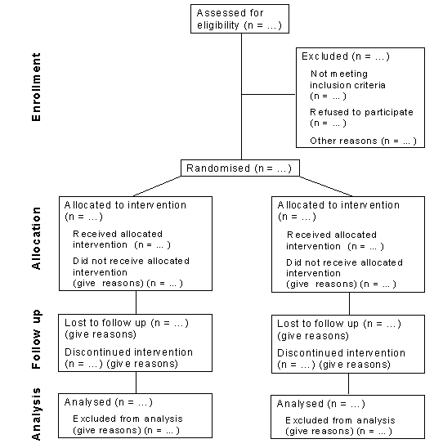

Slide 44
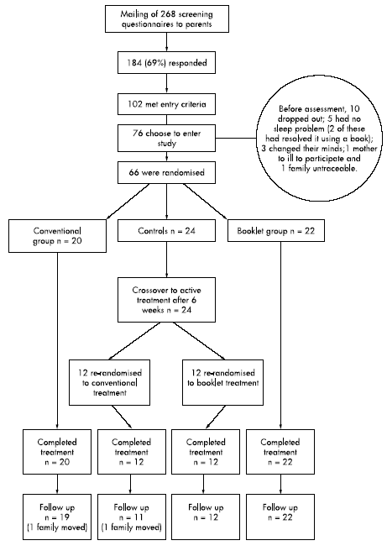

Slide 45
More on Bias…
Delgado 2004
Critical Appraisal Sheets from the Centre for Evidence-Based Medicine
http://www.cebm.net/index.aspx?o=1157

Slide 46
My idea for research
Linda Knox, Head, Department of Midwifery, BC Women’s Hospital & Health Centre, and Providence Health Care

Slide 47


Slide 48
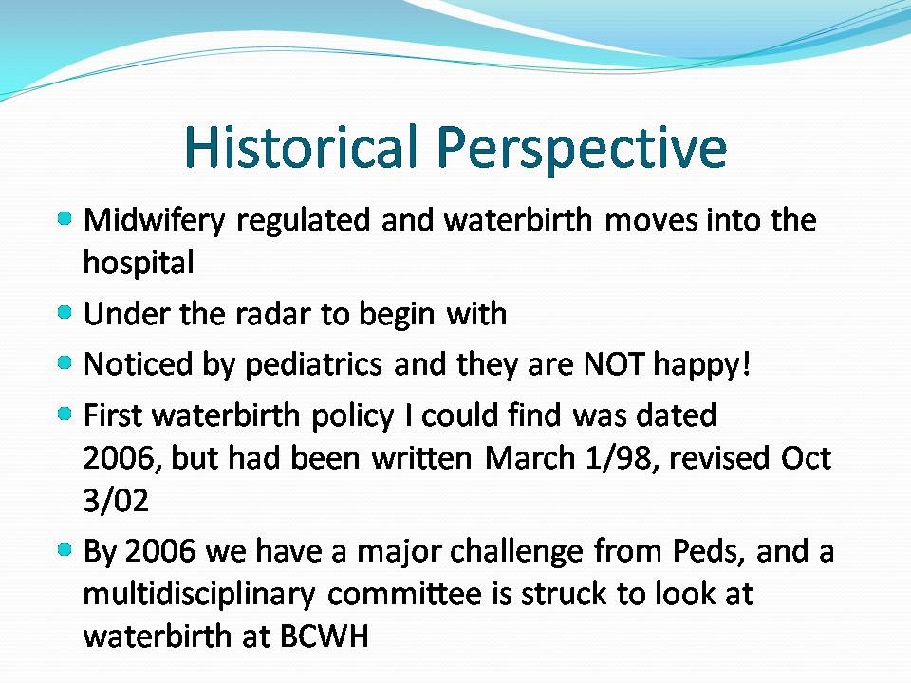

Slide 49
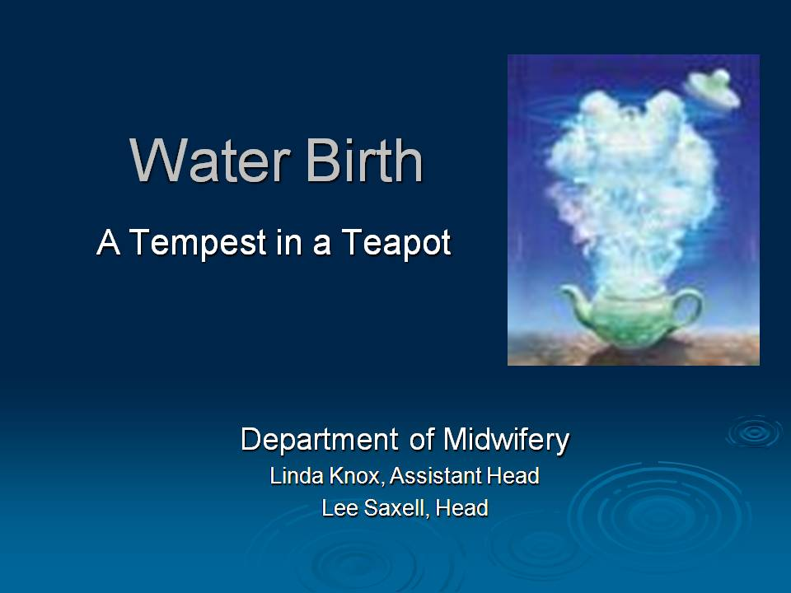

Slide 51
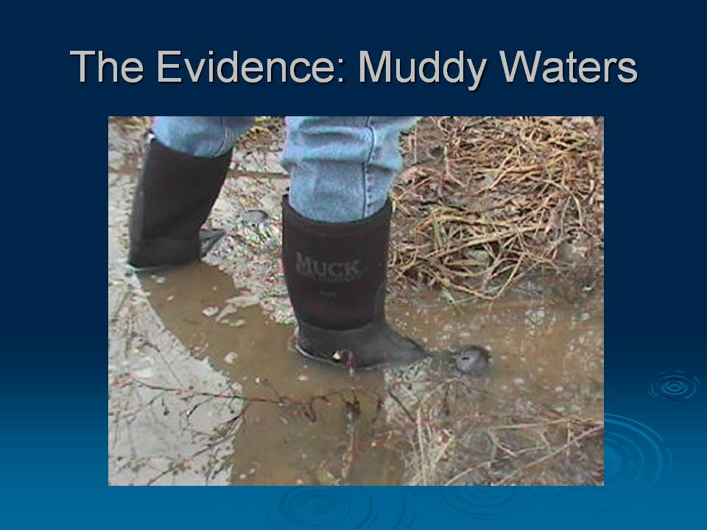

Slide 52
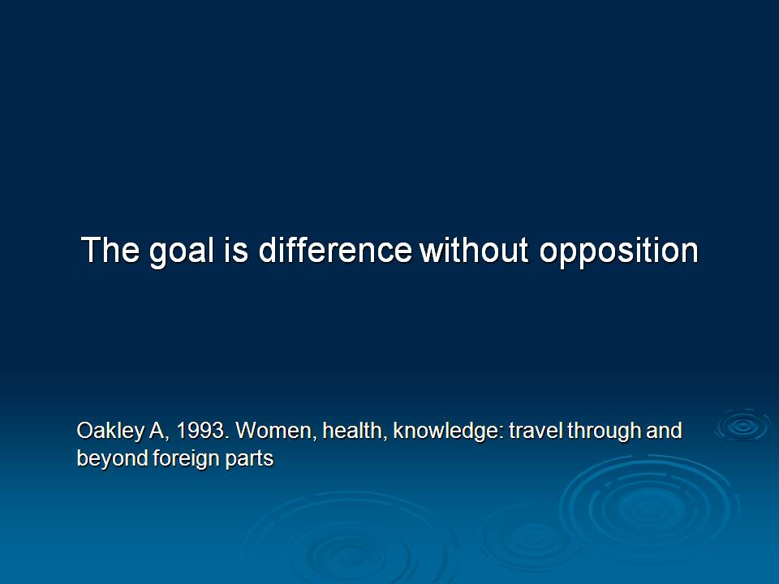

Slide 53


Slide 54


Slide 55
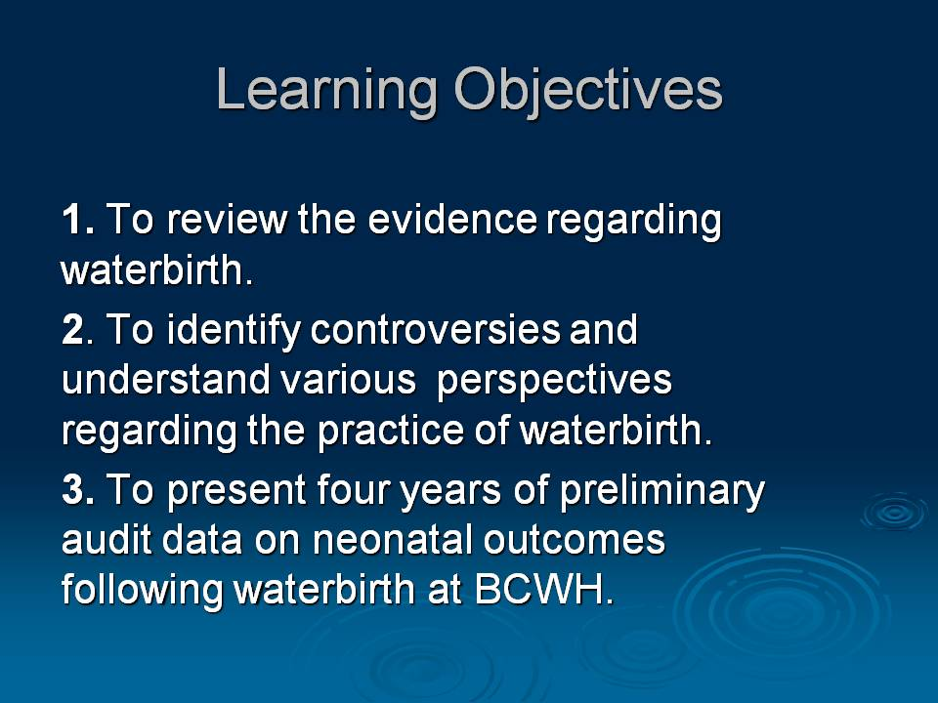

Slide 56


Slide 57
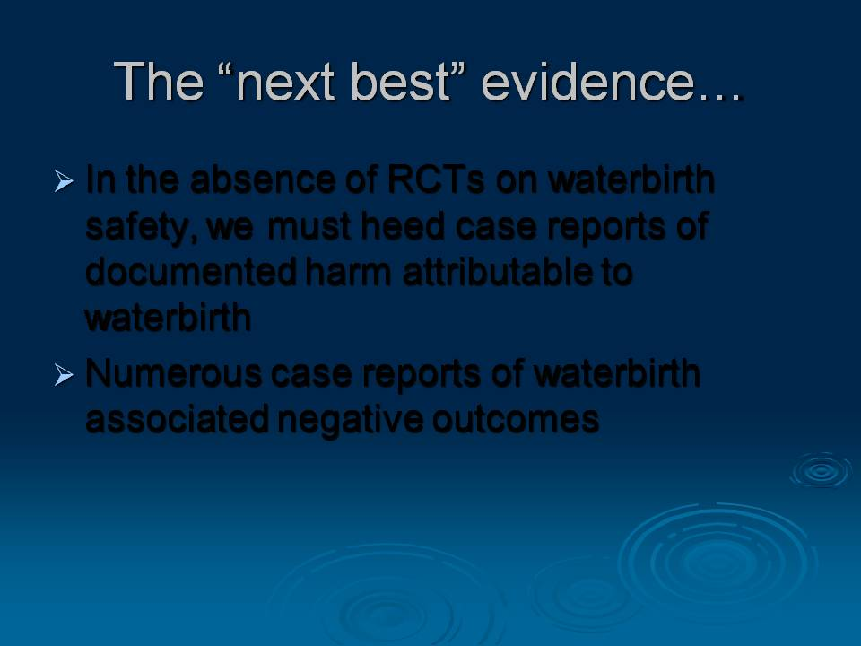

Slide 58
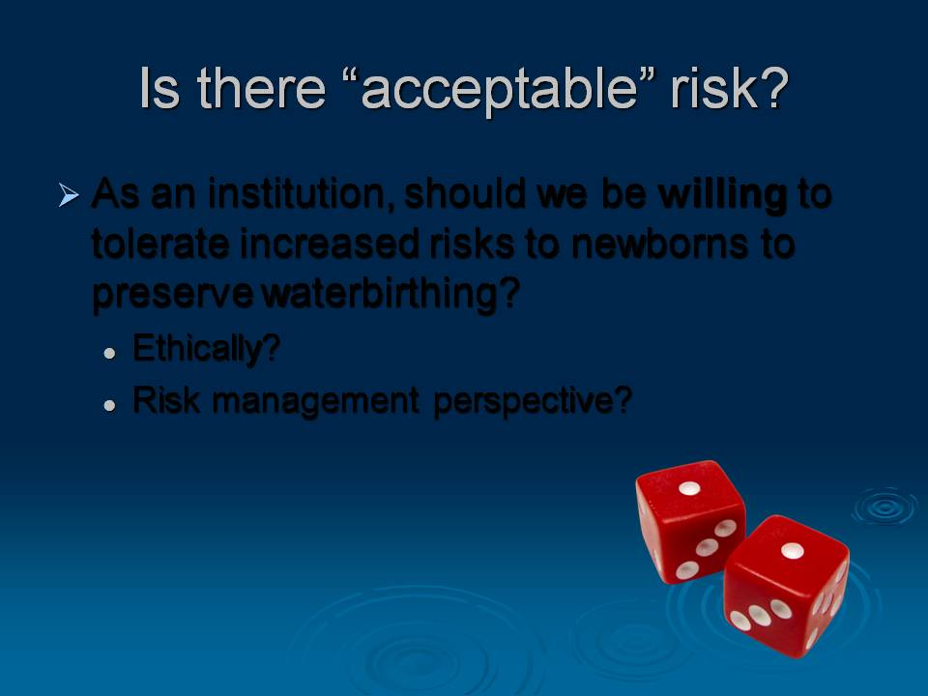

Slide 59
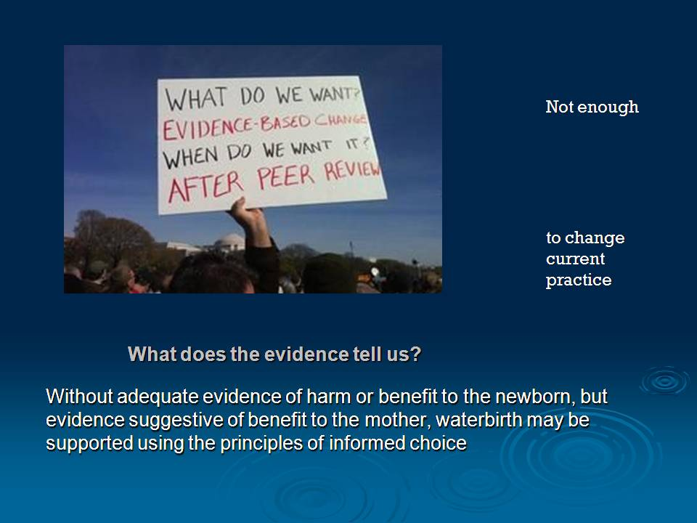

Slide 60
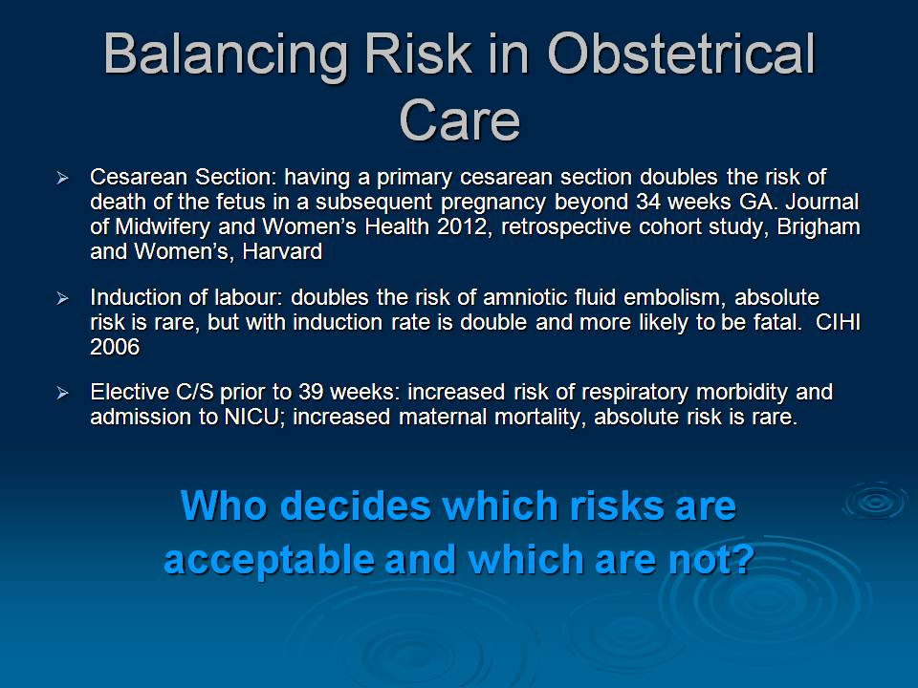

Slide 61
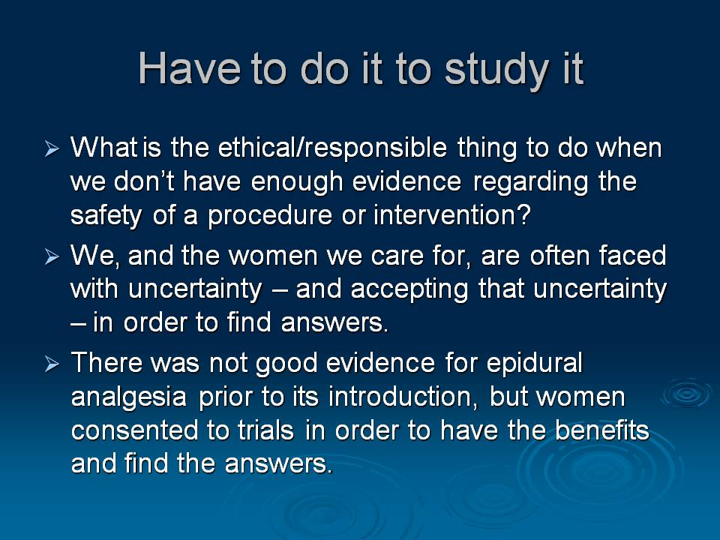

Slide 62
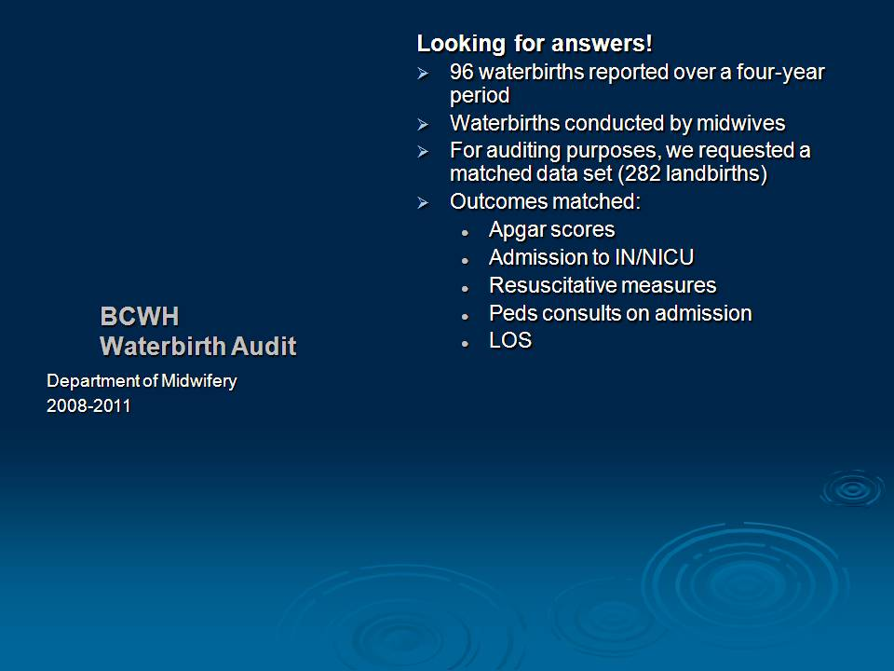

Slide 63
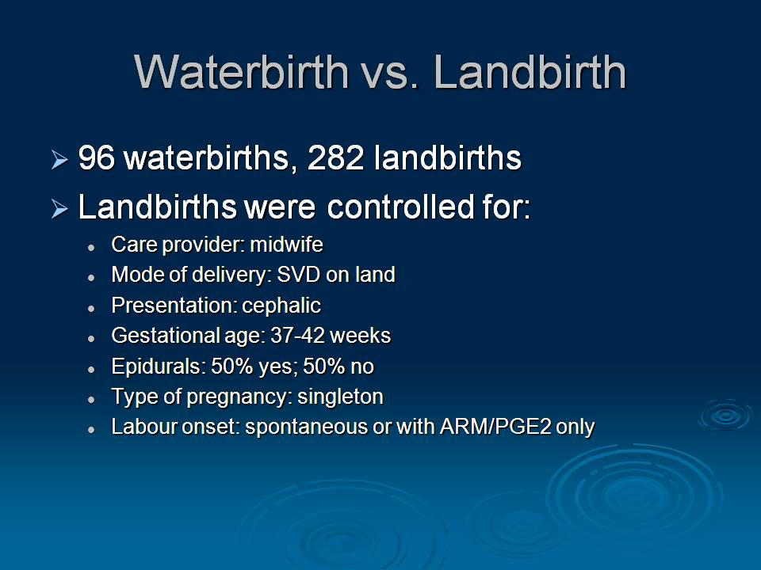

Slide 64


Slide 65
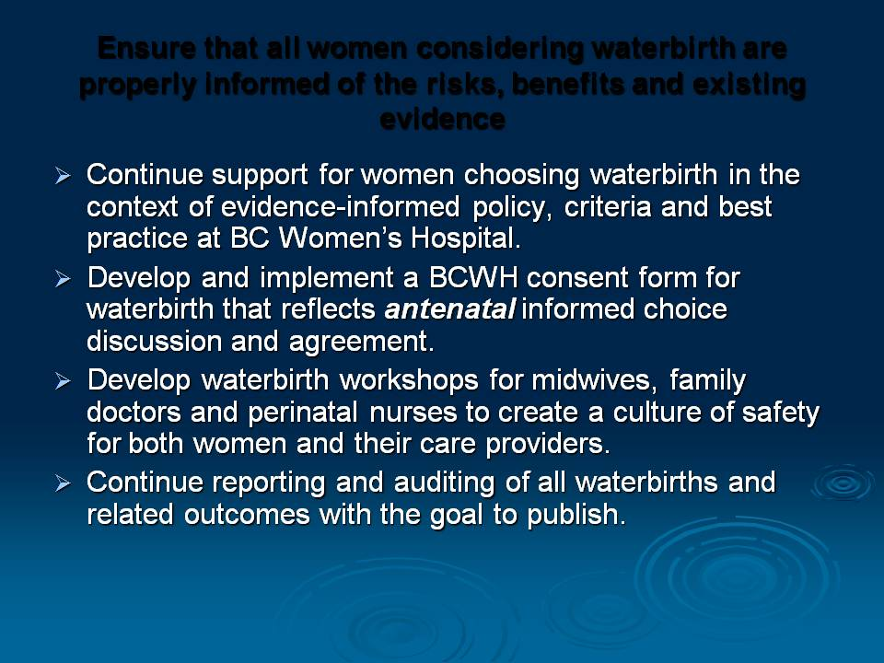

Slide 66
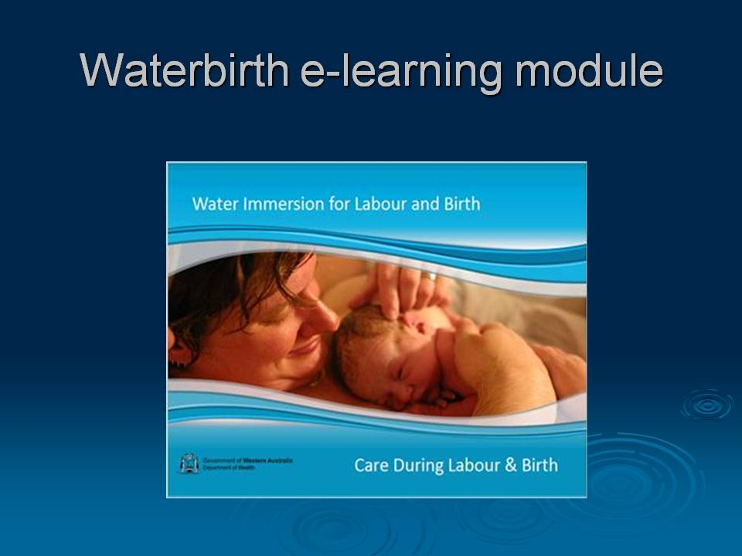

Slide 67
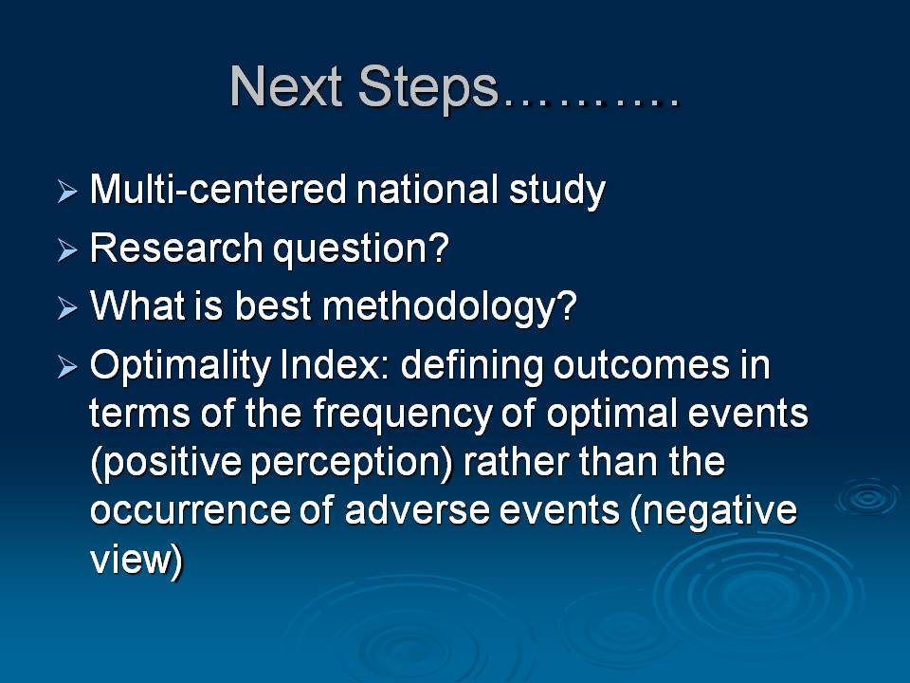

Slide 68
survey of midwives
(MATRIEX-Q) Preliminary Findings
Michelle Butler, Professor, Director, UBC Midwifery

Slide 69
Aims and design
Aims
To explore midwives’ interest in research, their involvement in research to date, experience of and training to conduct research, perceived training needs, and how the BC Midwifery Network can support these
Methods
Short, anonymous, on-line survey of midwives

Slide 70
Survey instrument
Demographics
Attitudes towards research
Involvement in research
Current research skills
Interest in the BC Midwifery Network

Slide 71
Participants
(n=57)

Slide 72
Education and Research Training

Slide 73
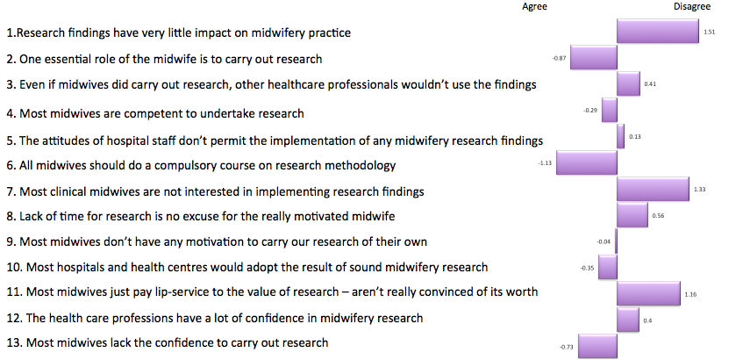
Midwives’ attitudes towards research

Slide 74
Current involvement in research and skills (%)

Slide 75
Priorities for research training (%)

Slide 76
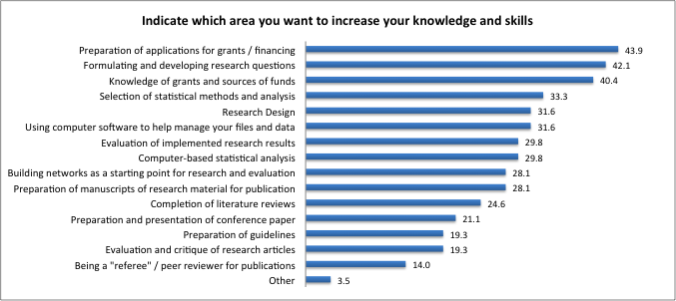
Skills needs (%)

Slide 77
Current research skills (%)

Slide 78
Interest in BC Midwifery Network (%)

Slide 79
Meeting days and times (%)

Slide 80
Issues in the press
Kim Campbell, Instructor, UBC Midwifery

Slide 81

In the Press
Midwifery Community of Practice Update
Febuary 2016

Slide 82
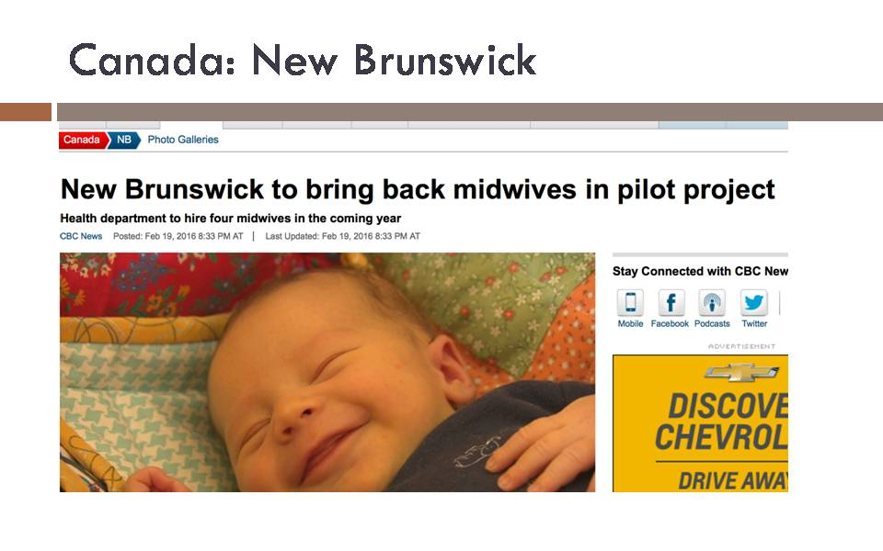

Slide 83
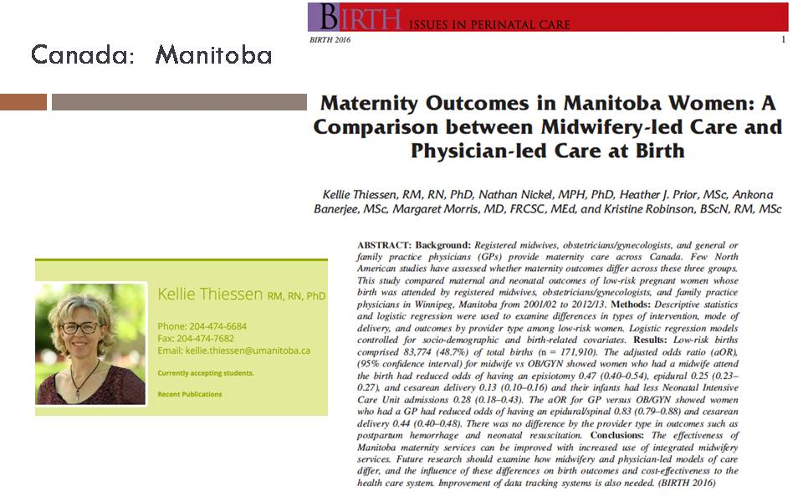

Slide 84


Slide 85
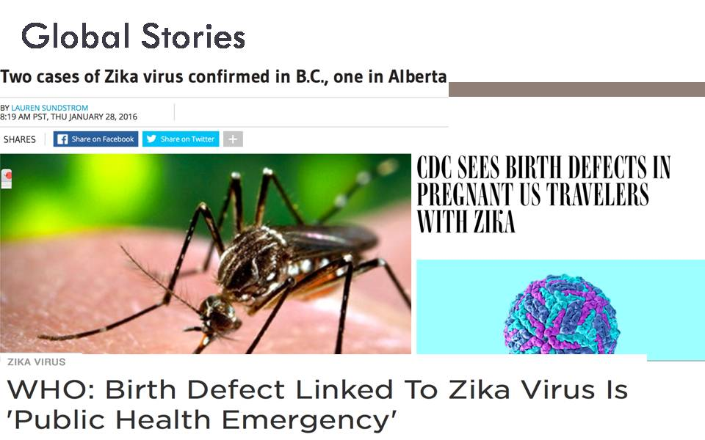

Slide 86
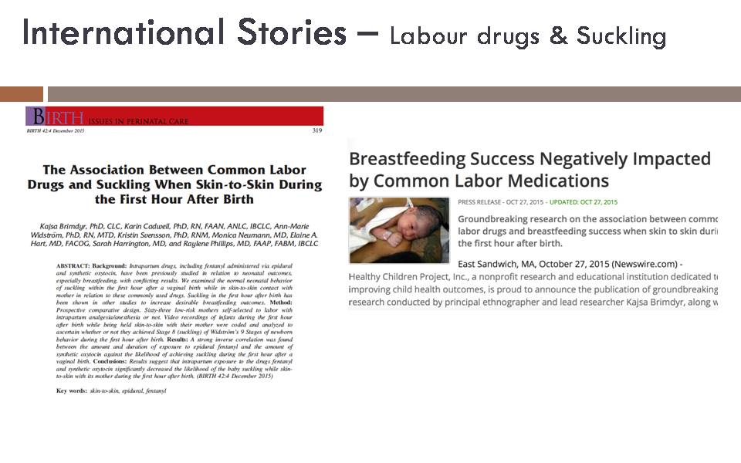

Slide 87


Slide 88
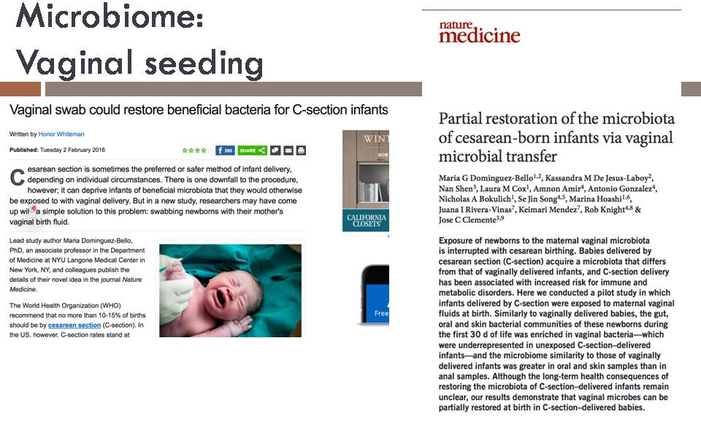

Slide 89
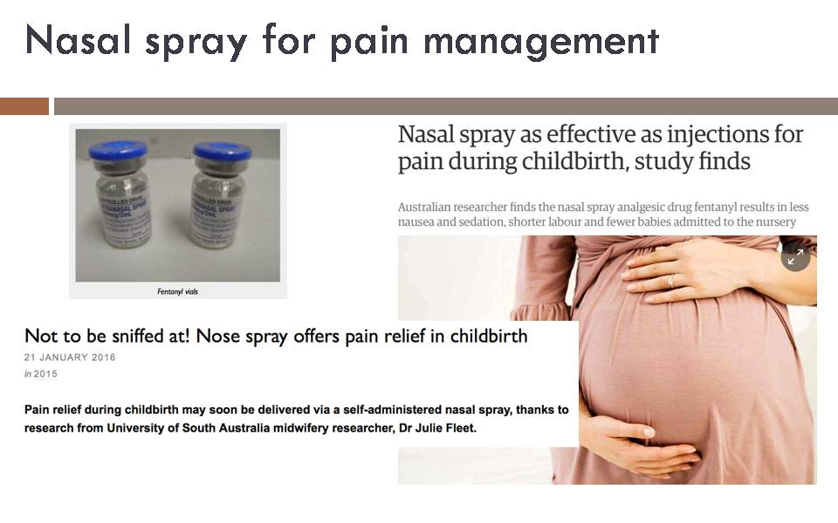

Slide 90
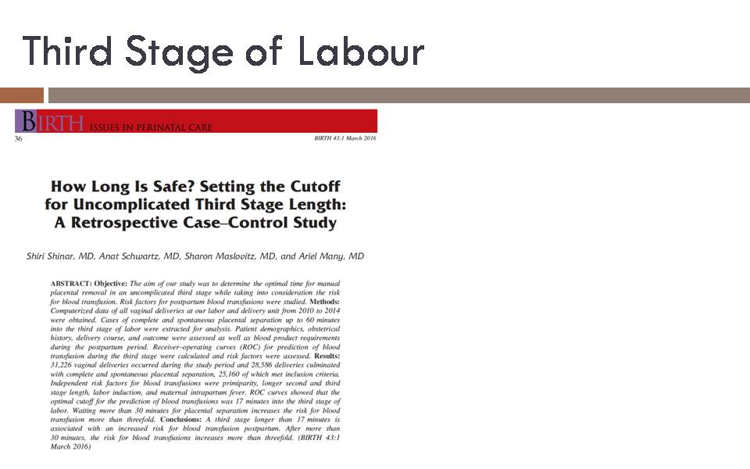

Slide 91
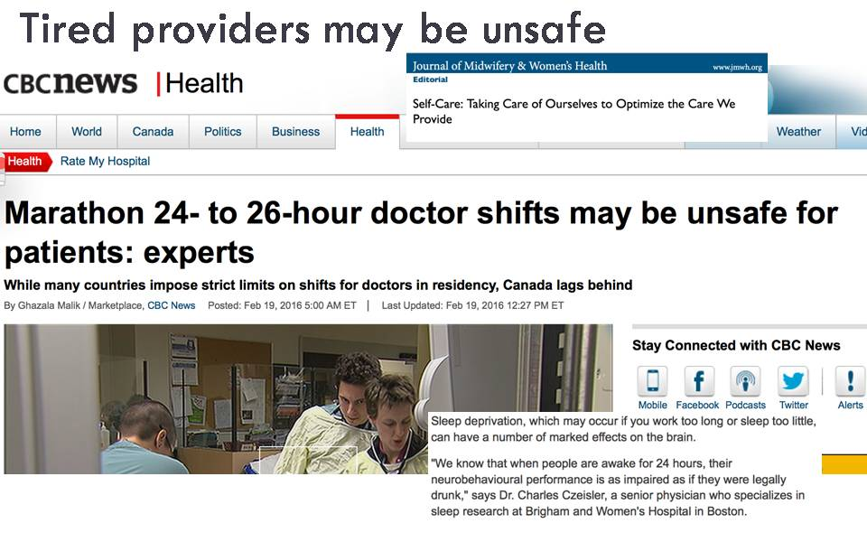

Slide 92


Slide 93
Closing Comments
Kathrin Stoll

