Slide 1
GENDER DIFFERENCES
Significantly more women than men preferred midwifery care (54.4 % versus 42. 5 %, x²=36.72, df=1, p < 0.001).
Women were significantly more likely to prefer out-of-hospital birth, compared to men (5.0 % versus 2.6% for home births and 11.0% versus 3.7% for deliveries in birthing centers, x²=58.65, df=2, p < 0.001).
There was a significant difference in normal birth intentions, by gender; 20.5% of women versus 11.3% of men preferred normal birth (x²= 39.86, df=1, p < 0.001).

Slide 2
Summary of Results
Overall, half of the students in our study preferred midwifery care in a healthy pregnancy, 1 in 10 would choose to give birth in a birthing center, and less than 5% would prefer a home birth.
Close to 90% of students chose vaginal birth, but only 1 in 5 preferred a vaginal birth without epidural anesthesia.
Women were significantly more likely to prefer midwifery care, out-of-hospital birth and normal birth, compared to men.
Preferences for midwifery care were associated with the proportion of births conducted by midwives in the countries studied.

Slide 3
GENDER DIFFERENCES
Men across the countries studied were significantly less likely to prefer midwifery care, out of hospital birth and normal birth.
Any educational or advertising strategies aimed at promoting midwifery care ought to take into consideration that men are most concerned with the safety of mother and baby [49] and need reassurance that midwifery care is safe. Men might also like to learn about the other benefits of midwifery care, such as labour & postpartum support, and family-centered care.
A Swedish study of 1074 pregnant women and their partners found that men were significantly more likely to prioritize pain relief compared to women [53]. Swedish pregnant women also placed a higher priority on natural childbirth than men.
Partners who are worried about their partner’s pain can be reassured that this is a common concern among men. The findings also draw attention to the need to encourage discussions among couples about their feelings about pain relief and how diverging preferences might be reconciled.

Slide 4
Consumer demand for community birth
Preferences for community births in our sample far exceeded actual rates across countries, with the exception of the US.
In our sample, 0.4% of US women preferred a home birth; the national home birth rate was 0.9% in 2014 [2].
We found high demand for home births in Chile (where this option is currently not available) possibly as an alternative to the highly medicalized hospital environment in Chile and reports of obstetric violence and strong pressure from maternity care providers to accept obstetric interventions [28, 50].
As consumer demand for out-of-hospital birth options generally outpaced availability there is a pressing need to increase the availability of alternative places of birth for healthy women with low risk pregnancies.
ICM states that women ought to have ‘the right to a home birth attended by midwives as a valid and safe option’ but recognizes that not all countries have legislation and health care systems that support home birth [52]. ICM urges these countries to work towards inclusion of home birth as an option.
Notes:
Seven percent of all Chilean students and 22% of young women in the standard cohort would like to give birth at home, possibly as an alternative to the highly medicalized hospital environment in Chile and reports of obstetric violence and strong pressure from maternity care providers to accept obstetric interventions [28, 50]. Over 50% of the Chilean students who participated in our cross-country study reported a graduate degree as the highest level of education completed. These students attended a liberal arts university and were more educated, on average, and older than students from other countries. These factors likely contributed to their high preference for home birth. Other survey research that was conducted at the same time in Santiago, at the Catholic University revealed that 0.2% of young women preferred a home birth and 11.7% would plan a delivery in a birthing center [51]. This comparison revealed that both groups of students desired out of hospital birth options but that home birth preferences were much higher among more educated, older, liberal arts students in Chile.

Slide 5
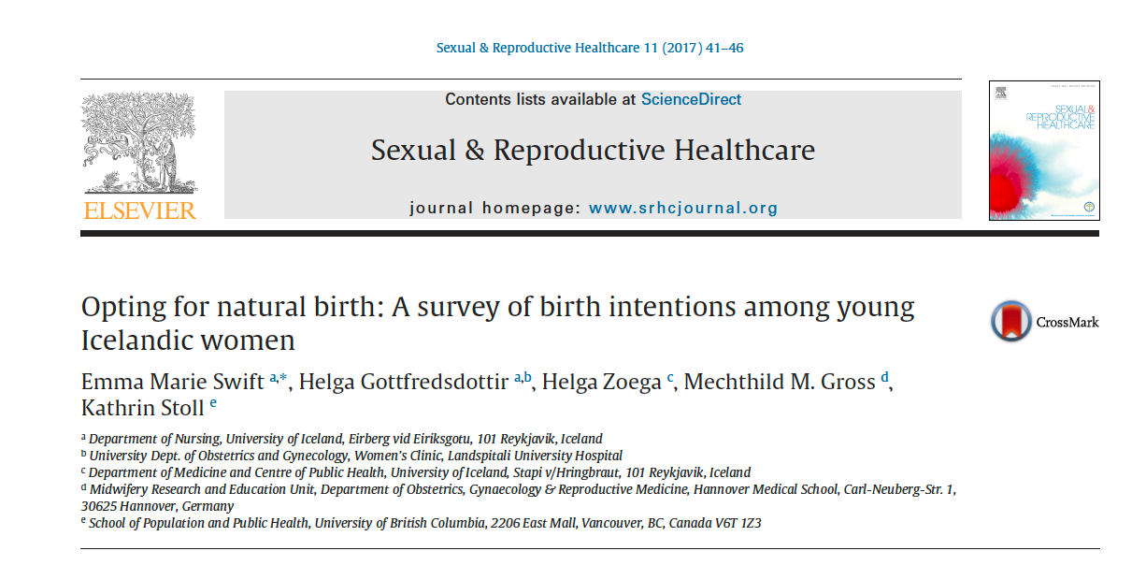
Why are normal birth intentions so high in Germany?
We found that German students, compared to students from other countries, were the least likely to report childbirth fear. For example, 21 % of German students had elevated childbirth fear scores (above the 75th percentile), compared to more than 30 % in Australia, NZ, England, and the US.
Confidence in their level of knowledge of pregnancy and birth was also highest among German students i.e. 44.3 % reported confidence, compared to 1 in 4 in Australia, Chile and the UK, 1 in 5 in NZ and Iceland and approximately 1 in 7 in the USA and Canada.
Childbirth fear and lack of confidence in knowledge of birth have been linked in country specific studies to reduced odds of having normal birth intentions
Notes:
To explore potential reasons why German students had much higher rates of normal birth intentions, we performed a descriptive post-hoc analysis with the standardized cohort.

Slide 6
Country RANKINGS
Young women in the UK had the lowest overall score, indicating they are most likely to prefer normal birth and midwifery care across settings.
This is potentially due to the wide range of birth options available to pregnant women in the UK that are supported by government policy and a universal healthcare system. Further, the popularity of ‘Call the midwife’ television series, and the fact that the UK has had almost universal midwifery care since 1904 are potential explanations.
In England, almost all women receive midwifery care (98%) throughout the maternity care episode (from first booking through pregnancy, labour and birth and up to 6 weeks postnatal) and over half of births (55.6%) in 2014 were conducted by midwives [32]. This means that young women are surrounded by family members or friends who had midwifery care, and these influential stories support midwifery care and normal birth.
Young women in the US had the highest overall score, indicating a strong preference for physician-attended medicated childbirth in hospitals.
There are several potential explanations for the US ranking, including limited access to midwifery care, fragmented midwifery regulation and place of birth options across states [44] and negative press coverage of adverse outcomes at midwife-attended home births [45].
There is also a lack of understanding of the training and scope of practice of different types of US midwives [46]. Further, young women in the US are less likely to be surrounded by family and friends who have experienced a midwifery model of care compared to young women the UK.

Slide 7
limitations
Participants in our study were all attending university and college, and more educated than the general population of 18-40 year olds. Hence findings cannot be generalized to the next generation of maternity care consumers across OECD countries. Significant resources would be required to survey a representative sample.
The response rates were low, but similar to other online student surveys [7,8,13].
Samples from different countries had quite divergent socio-demographic profiles. We partially addressed these differences by creating a standardized cohort when comparing data across countries. However, the sample sizes for the standard cohort were low in some of the countries and the age distributions among the 18-25 year olds were quite different in some countries (i.e. a higher proportion of younger students in the US versus the Chilean sample) .
Quantifying the country level proportion of midwife-conducted births was challenging due to differences in the way this information is collected and reported across countries. Some countries, like Canada, report the percentage of midwives who actively manage births (i.e. those who are the most responsible provider at the birth) whereas other countries report the number of births that are attended by midwives, whether they play an active role in the birth or not.
Finally, correlational analysis does not imply causation; however, it is more likely that midwifery coverage affects childbirth attitudes among young people than the other way around.

Slide 8
QUESTIONS

Slide 9
Discussion-Cont.
In a study by DeJoy [46], thematic analysis of responses from 459 US college students about childbirth and midwifery care revealed that most students could not differentiate between the different types of midwives that practice in the US.
Many doubted the quality of midwifery education and the safety of midwifery practice.
Dejoy et al. recommend that educational strategies focus on the safety of midwifery care and the training and certification requirements of midwives [46].

Slide 10
Discussion- Canada versus US
Despite similarly low levels of midwifery-conducted births in the US and Canada, students from Canada were more than twice as likely to prefer midwifery care than US students.
US students were also the least likely to prefer out-of-hospital birth options.
Why the differences between US and Canadian in student preferences for midwifery care across settings ?
US | CANADA
State legislative preferences for physician-controlled childbirth in the US Inconsistent regulation/licensure of midwives across states | RMs regulated in most provinces
Poor integration of midwives | Canadian RMs are relatively well integrated
Poor access to community birth options | Canadian RMs offer choice of birthplace
Different types of midwives, with different certification requirements and educational backgrounds | Only one type of midwife can gain registration in Canada through a four-year university degree

Slide 11
Planned KT activities
Website in four languages to educate young adults about childbirth, fear of birth etc.
Toolkits for consumers and educators. Educator toolkit will have lessons plans video suggestions, curricula (based on the survey findings)
Onsite birth education at schools (grade 4 and grade 11-delivered by midwives or trained educators)
Grade 5 education based on German model ‘ Hebammen in der Schule’
Need to collaborate with school boards, educators and midwives

Slide 12
Hebammen in der Schule

Slide 13
Midwives moves chronologically, starting with conception, pregnancy, labour and then birth

Slide 20
Inclusion of men

