Slide 1
Meeting
Wednesday October 4, 2017
12:00 – 1:30 pm

Slide 2
Agenda Welcome and Update
Karen Gelb, Manager, Knowledge Translation
UBC Midwifery Program

Slide 3
Agenda

Slide 4
“Addressing anxiety & depression during pregnancy: Maternity Care Provider perspectives”
A study by:
Julia Santana Parrilla, MSc. candidate
Dr. Hamideh Bayrampour, PhD
Dr. Susan Cox, PhD

Slide 5
Anxiety &/or depression during pregnancy
~ 1/3 women may experience anxiety symptoms during pregnancy (Bayrampour, McDonald, & Tough, 2015)
10% of Canadian women experience depression during pregnancy (Public Health Agency of Canada, 2012)
less than 15% of women experiencing anxiety or depression receive needed mental healthcare [Kingston, D., et al, 2014]
Notes:
Maternal mental health is considered a global public health issue (World Health Organization, 2017).
Unfortunately, the identification and treatment of anxiety and depression in the antenatal period has been largely neglected in research and care priority setting (Akiki, Avison, Speechley, & Campbell, 2016; Avni-Barron & Wiegartz, 2011; Bennett, Einarson, Taddio, Koren, & Einarson, 2004; Kopelman et al., 2008; Schetter & Tanner, 2012; Skouteris, Wertheim, Rallis, Milgrom, & Paxton, 2009).

Slide 6
Your role
MCPs are:
on the frontlines of care;
the most frequent point of contact with the healthcare system for expectant mothers;
experts in their knowledge needs and implementation contexts;
in the unique position to leverage their expertise to raise awareness and generate change to better support Canadian maternal health outcomes, and the efficiency and comprehensiveness of maternal care/service provision.
The goal of this project is:
to garner a deeper understanding of the challenges and complexities in addressing anxiety and depression during pregnancy from MCP perspectives.
Notes:
I argue: (a) women have limited involvement in decision-making and are unlikely to voice concerns (Jenksinson et al., 2016; Kingston et al., 2014); (b) the continuous nature of maternal care presents ample opportunity for MCPs to support women; (c) an understanding of MCP barriers/facilitators to addressing anxiety and depression during pregnancy will inform efforts to improve maternal mental health outcomes.
As the main and most constant point of contact with the healthcare system, MCPs are instrumental in improving maternal health outcomes.****

Slide 7
Interested?
Email Julia to set up an interview:
j.s.parrilla@alumni.ubc.ca
Or call:
604-440-9904
Thank you!

Slide 8
^{“How Does It Feel?} A narrative inquiry regarding Northern British Columbia Women’s experiences of the emotional and physical interactions between themselves and their clinical caregivers, during pregnancy, labour, delivery and the post-partum
A Qualitative Narrative Inquiry – Thesis Proposal – April 2017 Sarah Hilbert-West BSc Midwifery (UBC 2010), Med Counselling Candidate (UNBC)

Slide 9
Overview
Every day, women delivering babies experience a litany of talk and touch from clinical caregivers as they proceed through their labour and delivery or operative birth. Although many births go very well and many of these women have a joyous, empowering experience, during these interactions, some of the women may feel like their voices were not heard or respected, like they were misled or spoken to harshly or unfairly, like they or their baby were at risk, or subject to painful touch or discomfort.

Slide 10
Purpose of the Study and the Research Question
The goal would be to increase caregiver insight and empathy, and make caregivers aware of women’s experiences. The women would be heard and their voices shared, including identification of commonalities and shared experiences and themes. The woman would have an opportunity to be able to say how they felt to get “bad news,” to experience physical pain caused by a caregiver, to feel like they didn’t get information or if they felt they lost some body autonomy. The central research question would be
How do women from Northern British Columbia who have experienced clinical care during pregnancy, labour, delivery and the post-partum describe how they felt or were made to feel by communications from or the physical touch of their caregiver?
With the sub-question being the repeated use of questions in the following structure, “how did it feel (emotionally/physically) when your (caregiver) _____ (did/said) ______ during (moment)_______” with the questions following the order of the pregnancy journey from pregnancy, labour, delivery through the post-partum period.

Slide 11
^{Background of the Study}
As a medical practitioner providing clinical care to women, the researcher has often had women booking into care reporting previously traumatic or challenging birth experiences with prior caregivers. These challenging births may be related to clinical concerns, obstetrical emergencies or miscommunications, sometimes due to complications that are hard to avoid or minimize. However, on a regular basis the concerns clients present with are related to how they were treated, how they were spoken to, how they felt emotionally, how they perceived physical touch.
As a caregiver, the researcher strives for a client-centered, trauma informed approach in her clinical care. She works with many colleagues who provide excellent care, but may have been unknowingly party to a woman’s traumatic experience of her birth. As the researcher also has an interest in clinical teaching and precepting of midwifery, nursing, nurse-practitioner and medical students, she has an interest in creating resources to support empathetic, trauma informed care for women in the perinatal year.

Slide 12
^{Overview of the Proposal}
This research would involve detailed interviews with 6-8 women regarding their visceral pregnancy and birth experiences. The researcher would be looking for visceral language about how those women felt emotionally and physically at select moments in pregnancy, labour and birth. Included in these prompts would be moments regarding their physical experience of discomfort during clinical care. The onus would be on the researcher to not contribute to any additional trauma, while probing traumatic memories, so the researcher will remain sensitive to limitations in questioning. The researcher would aim to create a safe space where the participant feels safe to share freely.

Slide 13
Outcome
As an outcome, the researcher has a hope that the final study could be made available as a small bound book in structure for possible use for medical, nursing and midwifery students as a learning resource to give a window into women’s experiences, including feedback on the physical sensations. The goal would be to increase caregiver insight and empathy, and make caregivers aware of women’s experiences. The women would be heard and their voices shared, including identification of commonalities and shared experiences and themes. For example, the woman would have an opportunity to be able to say how they felt to get “bad news,” to experience physical pain caused by a caregiver, to feel like they didn’t get information or if they felt they lost some body autonomy during the process.

Slide 14
Methodology
For the purposes of this inquiry, the researcher has chosen to undertake a narrative inquiry. The rationale is two-fold: an interest in capturing unique voices and experiences and secondly, to co-create story and meaning without speaking for women. Using in-vivo coding will allow the researcher to share women’s unique experiences in an individual manner, while narrative thematic analysis will allow her to find commonalities of their shared lived experience. As a counsellor, the researcher is drawn towards narrative counselling modalities and feels undertaking interviewing and narrative inquiry is a natural match for her skill set.

Slide 15
^{Confidentiality and Anonymity}
The participants will be coded to anonymize their identities in the transcripts. Details that may identify the subject or a case will be redacted. The researcher will do in person interviews and consent the participants but their names and identifying information will be protected under lock and key as per protocols and, at the completion of the study, information management and protection protocols will be followed, with the consents and original tapes destroyed following the completion of the study.
To avoid any actual or perceived conflict of interest, the researcher will exclude from the study she herself has cared for in any capacity. As well, caregiver identifiers will be discouraged and, if appearing, will be redacted from transcripts. However, category of caregiver may be useful and will be left in transcript or inserted in replacement of identifying name (i.e. obstetrician, physician, pediatrician, midwife, doula, nurse).

Slide 16
^{Vulnerable Populations}
As the study questions, may raise traumatic or unpleasant memories, the researcher will conduct the interviews in a trauma informed manner. To minimize subjects being surprised by the content of the questions, the questions will be provided to subjects for review and familiarization with prior to the interview being conducted. The directions to subjects will indicate that subjects may indicate any questions that they are not comfortable with and they will be removed from interview sheet prior to start of that interview.

Slide 17
^{Validity}
In this narrative inquiry, stories are co-constructed and capture a moment in time. The stories are grounded in a specific geographical location (Northern British Columbia) to enhance validity, regarding an experience in time and culture. This will be made clear in the description of the study and outcomes, that the experiences are unique to this population and will give insight regarding same. The draft thematic analysis and final draft paper will be shared with subjects to confirm meaning and intent. Subjects will enhance validity by having opportunity to clarify meaning and experiences.

Slide 18
Occupational stress and intentions to leave the profession among BC midwives
Kathrin Stoll, Jocelyn Gallagher, Jude Kornelsen

Slide 19
Why is it important to study occupational stress among healthcare providers ?
Stress and burn out are linked to
Low job satisfaction
High job turnover
Lower quality of care
More medical errors
As we are moving toward patient-centered models of healthcare delivery it is important to understand the impact patient centered model have on care providers.

Slide 20
Background
Not much known about occupational stress among Canadian midwives
-a couple of qualitative studies done in Ontario
- one national survey done in 2008 (Unpublished Master’s thesis)
- Retention study currently happening at McMaster University, but no data collected yet

Slide 21
WHELM team meeting at ICM
WHELM SURVEY
Already was administered in NZ, AU, Sweden, Canada
Currently being administered in UK
Data collection planned for Germany

Slide 22
Sample
242 clicked on survey link
-9 midwifery students excluded
-14 did not answer eligibility questions
-23 were no longer practicing (15 from BC, 3 from AB and 8 from ON) and answered a short version of survey
196 currently working
130 in BC
36 in ON
29 in Alberta
2 in NWT, 1 in SK and 3 listed various provinces of work
BC Response rate:
Practising RMs: 130/264= 49 %
Non-practising RMs: 15/47= 32 %

Slide 23
Characteristics of participating BC midwives in active practice (n = 127)
 | n (%)
Practice structure Solo Team of 2-4 midwives Team practice > 4 midwives Inter professional/collaborative care Exclusively locum Other | 23 (18.1) 74 (58.3) 8 (6.3) 9 (7.1) 5 (3.9) 8 (6.3)
Size of community where MW primarily works Small rural or remote (< 10,000 ppl) Small rural area (pop 10,000 to 24,999) Large rural centre (pop 25,000 to 99,999) Metropolitan centre (pop >100,000) | 14 (11.0) 19 (15.0) 27 (21.3) 67 (52.8)
Average age: 41 years
Average years of experience working as MW in Canada: 9 years
14 (10.8%) were in first year of practice
Notes:
The majority of midwives practice in large cities or rural centers in teams of 2-4 midwives.

Slide 24
Case load and characteristics of clients
How many women did you provide continuity of midwifery care to last year? (n=109)
Range: 6- 180 women; mean: 43 women
Over the last year what percentage (out of 100) of your caseload could be described as having complex social or medical issues (eg. drugs, family violence, obstetric high risk conditions)? (n=128)
Range: 1- 5% of women, mean: 2.3 %

Slide 25
Over the last 12 months have you considered leaving the midwifery profession? (n=120)
Notes:
2 in 3 midwives have thought about leaving the profession in the last 12 months and 9% are making exit plans

Slide 26
Reasons for wanting to leave, rank-ordered (n=86)
Negative impact of on-call schedule on personal life: 83.9 %
My mental health: 79.3 %
My physical health: 58.6 %
Professional costs (license, insurance, dues): 54.0 %
Lack of support for sick days or vacation cover: 51.7 %
Dissatisfaction with working conditions: 43.7 %
Lack of career pathway/opportunities to progress: 39.1 %
Inability to find off-call work: 39.1 %
Family commitments: 37.9 %
Dissatisfaction with the model of midwifery care: 35.6 %

Slide 27
Reasons for wanting to leave, rank-ordered (n=86)
Experience of bullying: 34.5 %
Poor pay: 29.2 %
Scheduling challenges: 29.2 %
Inter professional conflict: 24.1 %
Dissatisfaction with my role as a midwife: 18.4 %
Fear of litigation: 14.9%
Dissatisfaction with level of consultation about workplace policy: 13. 8%
Challenges related to working in a rural area: 13.8 %
Conflict with other midwives: 10.3 %

Slide 28
Reasons that were reported by < 10% of midwives
Barriers to maintaining competency (min. birth numbers): 8.0 %
Issues with gaining or renewing hospital privileges: 8.0 %
Planned retirement: 10.3 %
Planned career change: 4.6 %

Slide 29
Reasons for wanting to leave (n=86)
‘The demands put on us for what we get paid is a joke’
Sometimes I feel that with no other training or degree I feel trapped into staying in my profession but I wish I could change for all of the above reasons.
Sub-culture within the profession that asks that you sacrifice your own well-being and that of your family for the advancement of the profession and in order to provide continuity of care. Feeling that I am required to prove myself as a midwife by sacrificing my personal well-being for the sake of my career.
Mostly stress and difficulty of living with life on-call. Love the work, not the call.

Slide 30
What factors contributed to your decision to stop practicing midwifery ? (n=23)
Planned retirement: 0 %
Negative impact of on-call schedule: 47.8 %
My own health: 47.8 %
Experience of bullying: 39.1 %
Dissatisfaction with working conditions: 39.1 %
Dissatisfaction with model of midwifery care: 34.8 %
Family commitments: 34.8 %
Lack of career pathway/opportunities to progress: 34.8 %
Notes:
Not restricted to BC, to maximize sample size.

Slide 31
Did any other factors contribute to your decision? Please explain
‘Extremely hard on my marriage. Midwifery was the main conflict in our marriage’.
‘My child was sick and it was impossible to maintain a call schedule and be with her when she needed’.
‘My overall health and continual lack of sleep’
‘Our model makes it difficult to go back in a part-time way, it seems as if it is 'all or nothing’..’

Slide 32
What factors and supports would need to be put in place for you to consider returning to active practice?
‘Shift work, opportunities to provide health care in alternate settings other than full scope midwifery (ie public healht/postpartum care / sexual health clinics / well woman care, physician assistant)’
‘Either a different model of practice or 24 hr call shifts’
‘Days off, coverage for days off that are needed (sick days, days to be with children when they are sick). Midwifery is not a mother friendly career’.
‘A practice that supports a midwife with disabilities and unable to be awake overnight and carry heavy equipment! A part time position in prenatal and postpartum care and education!
Notes:
Desire for part time work options, expanded roles, predictable schedules, more time off, more work family balance.

Slide 33
Are you always able to take your planned days off? (n=126)
Yes: 52 (41.3 %)
No: 74 (58.7%), Reasons:
Feeling of obligation to clients/wanting to provide continuity of care: 34.6 %
No cover: 33.8 %
Financial constraints: 20.8 %
Asked to work extra hours: 12.3 %
Low volume practice/insufficient birth numbers : 12.3 %
Other (please specify): 21.5 %

Slide 34
Days off
Vacation days in the past 12 months: Range 0-136, Mean: 37 days
When asked how many sick days or stress leave days midwives took, almost all answered 0.
‘We can only take sick days by asking another partner to cover for us. We only do so if we physically cannot work as it's a huge imposition for the other midwife. We often work when we are ill’
We are unable to take time off to recuperate after a stressful event for the reasons laid out in the "sick leave" category. The knowledge of lack of stress leave is, in itself, stressful.

Slide 35
Over the past 12 months, which work related stressors did you experience? Please only check the response if you experienced stress as a result.
 | %
Work load too high/not enough time off | 66.9 %
Too little work | 22.3 %
Conflict with midwifery colleagues | 36.9 %
Conflict with other health professional colleagues | 40.0 %
Conflict with hospital administrators/staff | 17.7 %
Conflict with client (s) and/or families | 27.7 %
Poor maternal or newborn outcome(s) | 36.9 %
Problems with maintaining or obtaining hospital privileges | 12.3%
Threat of or actual disciplinary action | 5.4 %
Difficulties supporting normal physiologic birth in hospital | 36. 9 %

Slide 36
30.0 % reported other stressors, e.g.:
‘I worked in a very high-volume practice and was pushed to work way more than was healthy’
‘Lack of standardized approaches to care from one area to the next, ie no option for breech vag birth, lack of experience from consultants, high csection rate in hospital’
‘Major abuse/ bullying from the obstetricians in our community with almost no support from CMBC/MABC’
Stress related to constantly negotiating different beliefs about birth with other professionals. Stress related to clients choosing care outside of community standards. Stress related to abnormal findings in labour (but outcomes fine). Stress related to never knowing what might happen at any time.

Slide 37
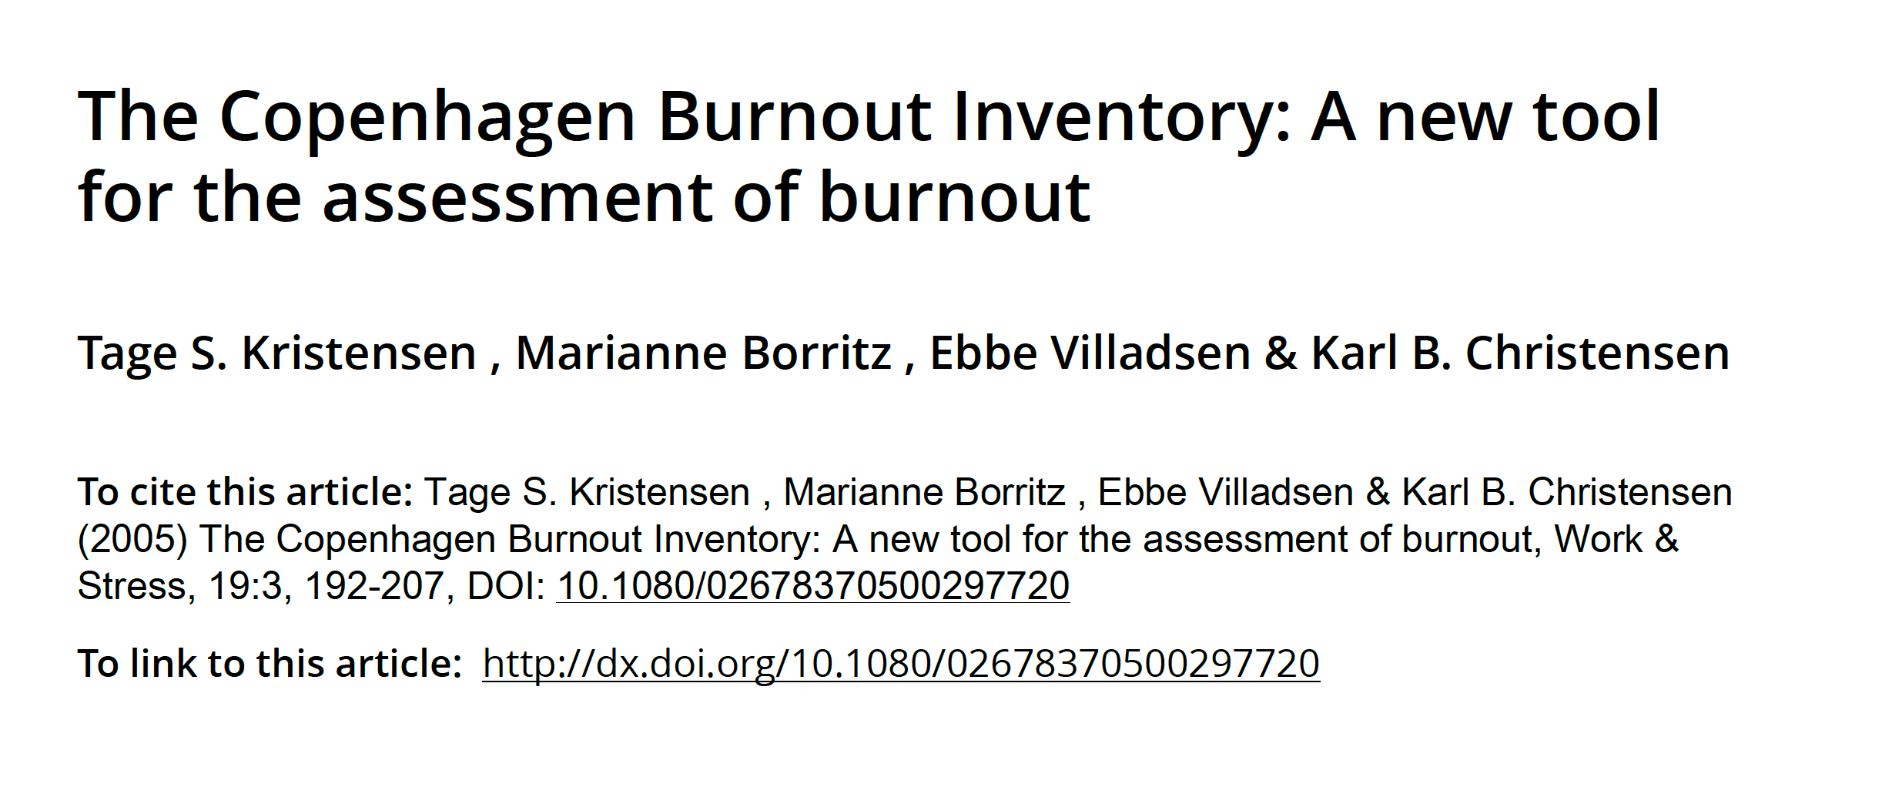
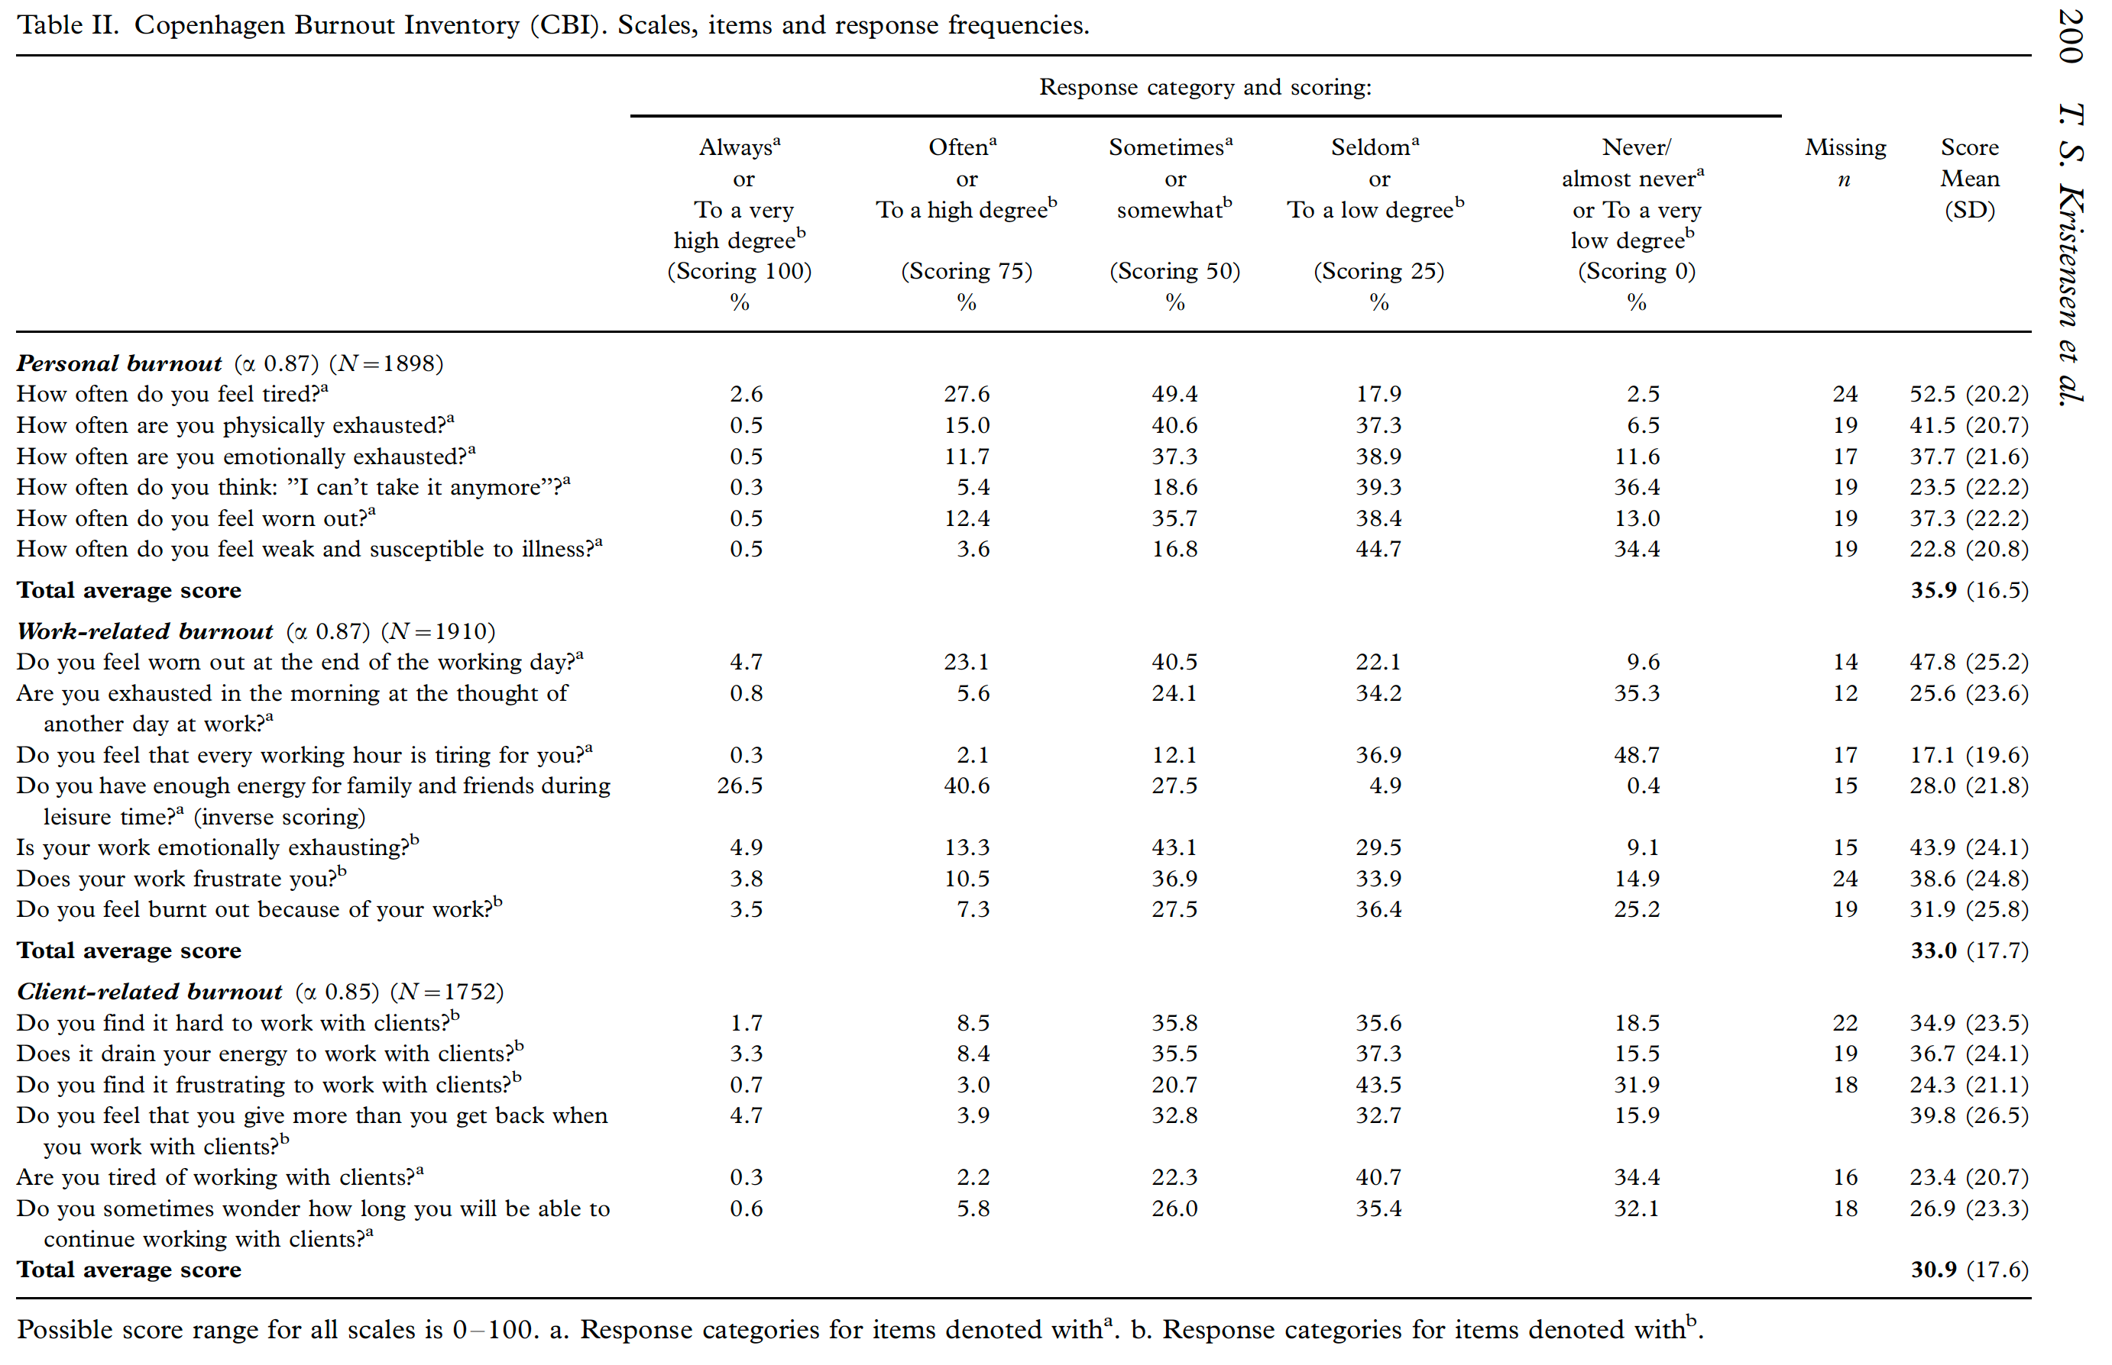
Copenhagen Burnout Inventory

Slide 38
Description of scales included in survey
Name | Number of items | N | Mean | Alpha
Copenhagen Burnout Inventory Personal Work Client | 6 7 6 | 143 137 143 | 60.4 46.8 28.5 | 0.90 0.89 0.91
DASS-Depression | 7 | 142 | 4.2 | 0.89
DASS-Anxiety | 7 | 138 | 3.4 | 0.77
DASS-Stress | 7 | 137 | 6.9 | 0.86
Quality of Life Scale | 15 | 127 | 66.1 | 0.93
Modified Practice Environment Scale | 14 | 126 | 2.8 | 0.85
Modified Perceptions of Empowerment in Midwifery Scale | 10 | 133 | 4.0 | 0.79

Slide 39
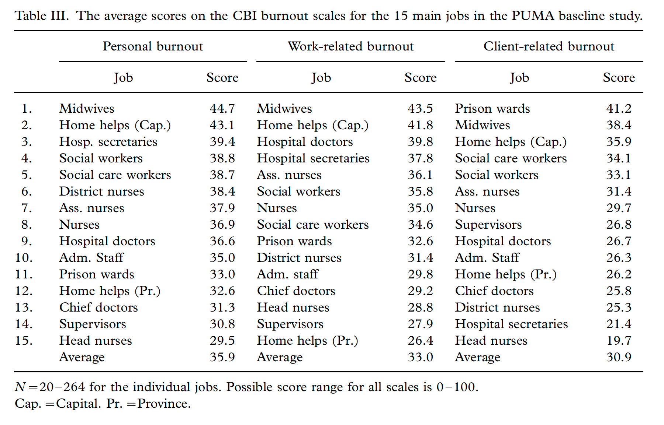
Name | NZ midwives Self-employed | NZ MWs Employed | Canadian MWs | Swedish MWs | AU MWs
Copenhagen Burnout Inventory Personal Work Client | 52.5 39.7 23.9 | 53.9 42.8 22.9 | 60.4 46.8 28.5 | 44.7 43.5 41.2 | 55.9 44.7 19.3
Notes:
Canadian MWs highest burn out scores, with exception of client burn out (Swedish midwives were highest)
Personal burn out highest among Canadian RMs, client burn out lowest.

Slide 40
Correlation between Copenhagen Burnout Inventory and
Depression, Anxiety, and Stress Scales (DASS-21)
 |  | DASS Dep | DASS Anx | DASS Stress
CBI Work | Correlation coefficient | .499 | .395 | .465
CBI Client | Correlation coefficient | .424 | .281 | .376
CBI Personal | Correlation coefficient | .492 | .432 | .490

Slide 41
How likely is it that you will still be working as a midwife in the future?
Notes:
Over 30 % of midwives said it is unlikely or highly unlikely that they will still be working as a midwife in 5 years.

Slide 42
Final words
I am done, but hypothetically if the following were in place I might have stayed longer: (1) Better pay (2) more flexible model of practise (3) career ladder vs work till you drop (4) Opportunities for post graduate education (5) Model of Midwifery administration/ bureaucracy that mirrors the stated values to the women in care back to the care providers (i.e. respectful. women centred, empathetic etc) vs petty, controlling and over-regulated) (6) Respect for the experience, maturity and perspectives that elder practitioners have to offer (7) Resistance to over medicalized model of care and more respect for traditional midwifery vales and skills (8) Examination of the culture of busy harried & overworked midwives as a positive role model

Slide 43
2017-2018 Meeting Dates

Slide 44
Closing Comments
Karen Gelb

