Slide 1
Meeting
Thursday May 4, 2017
10:00 – 11:30 am

Slide 2
Agenda Welcome and Update
Allison Campbell, Instructor and Undergraduate Program Lead,
UBC Midwifery Program

Slide 3
Agenda

Slide 4
Pregnancy Specific Anxiety scale
Hamideh Bayrampour, PhD

Slide 5
Pregnancy specific anxiety
Nervousness and fear about the baby’s health, the mother’s health and appearance, experience with the health care system, social and financial issues in the context of pregnancy, childbirth, and parenting, accompanied by excessive worry and somatic symptoms
Sometimes associated with maladaptive behaviour such as excessive reassurance seeking and avoiding behaviours
http://dri6hp6j35hoh.cloudfront.net/blog/wp-content/uploads/2012/03/Pregnant-woman-window-3.jpg
Notes:
Pregnancy specific anxiety is defined as nervousness and fear about the baby’s health, the mother’s health and appearance, experience with the health care system, social and financial issues in the context of pregnancy, childbirth, and parenting that are accompanied by excessive worry and somatic symptoms.
Pregnancy specific anxiety may also be associated with maladaptive behaviour such as excessive reassurance seeking and avoiding behaviours

Slide 6
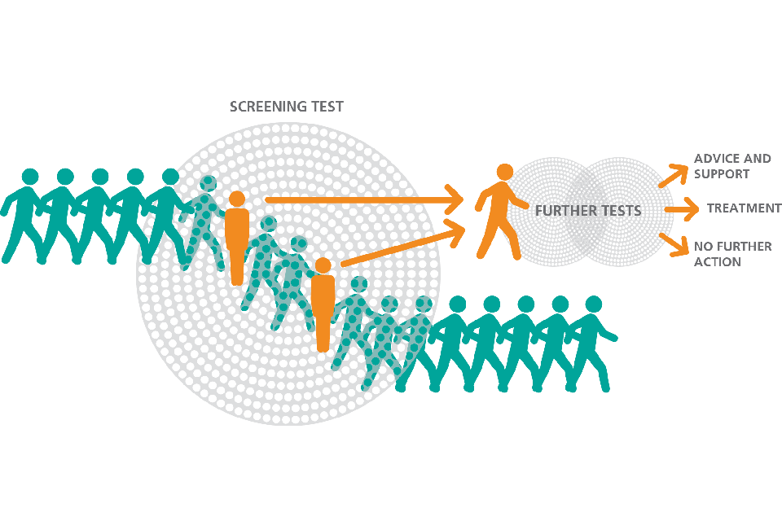
Screening for Anxiety
Few specific scales developed
Factor analyses show there are missing dimensions in current measures and they do not sufficiently reflect diffuse and multidimensional construct of PSA primarily due to poor conceptualization of the concept
https://assets.publishing.service.gov.uk/government/uploads/system/uploads/image_data/file/35249/UK_NSC_sieve.png
Notes:
Three six-item forms of the State Anxiety Inventory scale have been constructed.

Slide 7
Gap
In a 2015 systematic review of current specific scales, Brunton et al concluded current scales lack sufficient scope and depth
using too few items
as part of the broader construct of prenatal stress
The need for a valid and reliable tool (Furber, 2009; Johnson, 2003; Meades, 2011)
Notes:
In a 2015 systematic review of current specific scales, Brunton et al. noted that PrA has been examined using too few items or as part of the broader construct of prenatal stress. They concluded that the current scales lack sufficient scope and depth to measure PrA (25). The reviewers restated the need for a well-developed scale with a rigorous theoretical and psychometric basis for the assessment of PrA, a need that has also been identified by other experts in the field (13, 24, 25).

Slide 8
Concept Analysis
To clarify the concept of PSA and identify its attributes, domains, antecedents, consequences (Bayrampour H, Ali E, McNeil DA, Benzies K, MacQueen G, Tough S. Int J Nurs Stud. 2016; 55:115-30)
Modified approach of Walker and Avant (2005)
We assessed the items of the current scales to:
Determine dimensions and attributes examined by each scale
Identify gaps in the current scales

Slide 9
Dimensions and Antecedents
Nine dimensions were identified:
Anxiety about fetal health, fetal loss, childbirth, and parenting and newborn care, mother’s well-being, body image, health care-related issues, financial issues, and family and social support
Three antecedents:
Real or anticipated threat to pregnancy or its outcomes (risk)
Low perceived control
Cognitive activity and excessive thinking (an attribute as well)

Slide 10
Consequences
Excessive reassurance-seeking behaviors
obsessive counting of fetal movements, frequent calls and visits to health care providers, requests for additional ultrasounds, requests for surgical delivery
Avoiding behaviours
withholding attachment, depersonalization and detachment, not wanting to start dreaming about pregnancy, avoiding discussion of pregnancy, avoiding revealing their pregnancy
Negative daily impacts
difficulty concentrating, indecisiveness, and feeling dysfunctional
Notes:
Less frequently reported.. not very clear

Slide 11
What are the gaps in the current specific measures?

Slide 12
Item development
Qualitative interviews
Concept analysis
Previous items
Over 140 items

Slide 13
Content validity
Invited 10 experts
7 provided feedback
Content validity indices
Revised items
83 items

Slide 14
Pilot study
Face validity
20 pregnant women
Cognitive interviewing
Ethics approval
Just started recruitment

Slide 15
Next steps
Revising the PSAS based on findings of pilot study
A larger study to conduct factor analysis for item reduction
A second study to validate the tool against clinical diagnosis

Slide 16
Informed Refusal of Postdates Induction
Research Idea
Luba Butska RM PhD

Slide 17
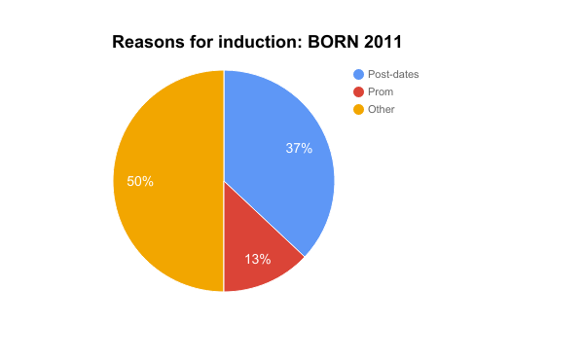

Slide 18
Hannah Trial 1992
RCT at >= 41 weeks
3407 women
Induction within 2-3 days (study group) vs monitored (control group)
Serial monitoring : FM count and AFV + NST 2-3 per week
Induced: NST abnormal, low AFV, OBS complication, 44 w

Slide 19
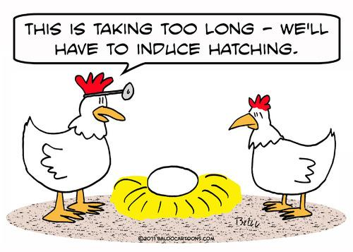
Hannah Outcomes & Result: IOL @41
Rate of CS: lower in induction group
Perinatal mortality and neonatal morbidity: similar
Routine offer of induction at 41+0

Slide 20
Department of Midwifery: Postdates Pregnancy
Vancouver
Association of Ontario Midwives: When your pregnancy goes past your due date
AOM
ACOG Guidelines: Management of Late-term and Postterm Pregnancies
ACOG

Slide 21
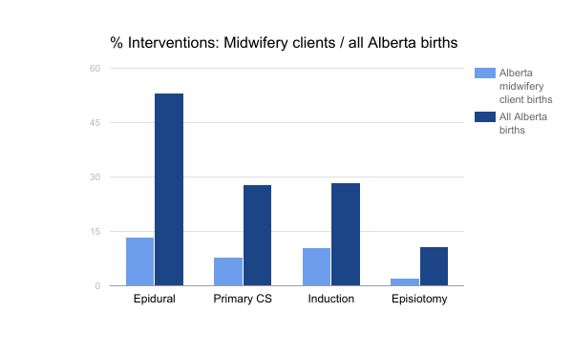

Slide 23
ARRIVE
“A Randomized Trial of Induction Versus Expectant Management”
6000 nulliparas: singleton uncomplicated term pregnancies
Elective induction at 39 weeks (39+0 - 39+4)
Reduces risk of neonatal morbidity and perinatal mortality
https://clinicaltrials.gov/ct2/show/NCT01990612

Slide 24
Study Design Questions
Prospective study Comparison group? Clinical Factors
BCLabor&BirthSummary Midwifery clients Age
Ontario Statement of Live Birth Monitoring
Induction at 42w
Cervix
“Natural” methods

Slide 25
l
THANK YOU!
Luba Butska RM
lubamidwife@gmail.com

Slide 26
Closing Comments
Allison Campbell

