Slide 1
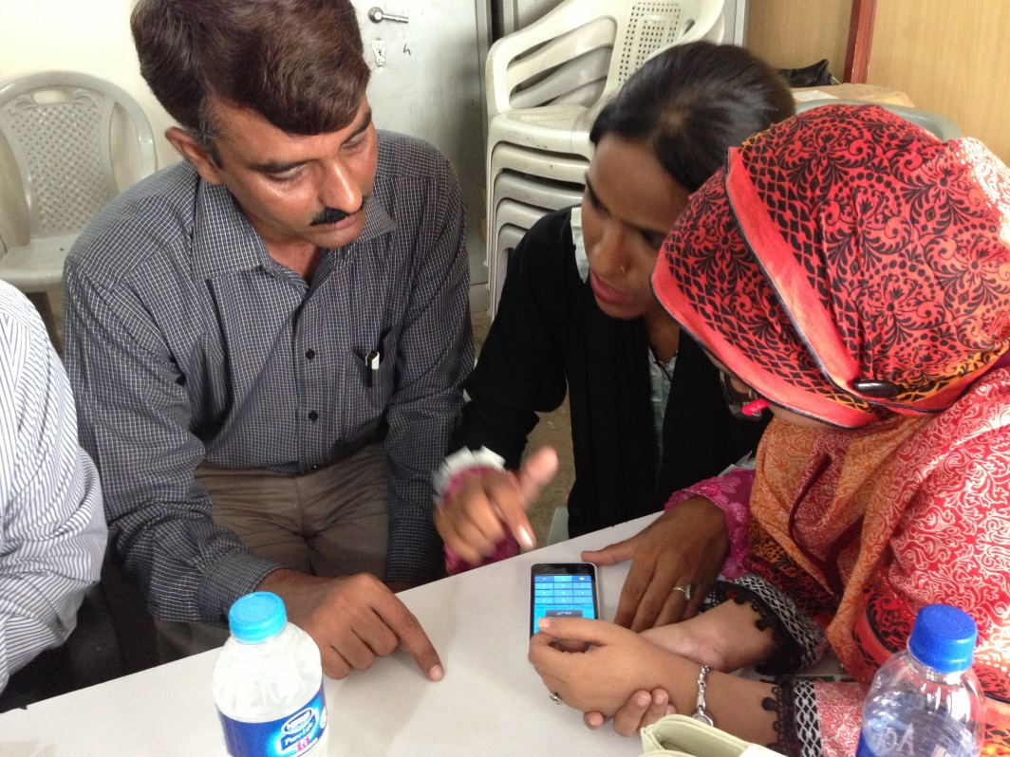
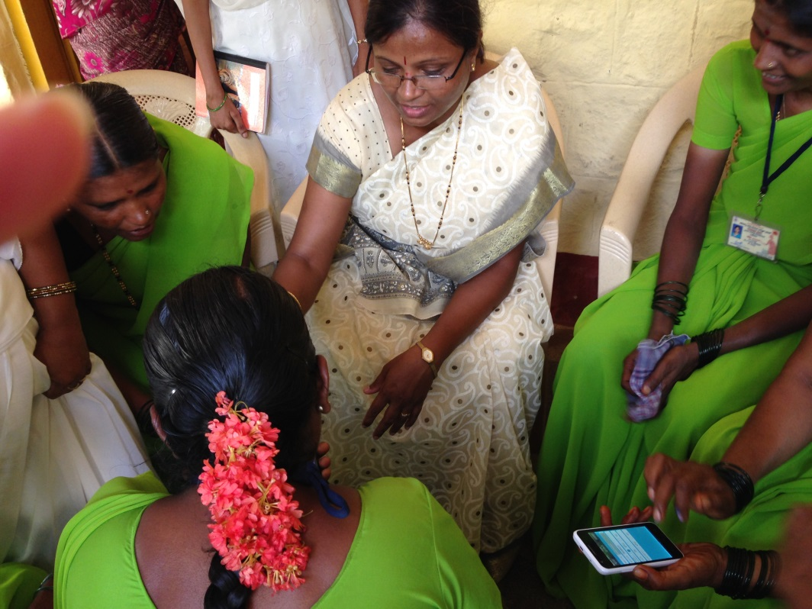
Diaphragmatic breathing and mobile health
Beth Payne, PhD
Postdoctoral Fellow, UBC

Slide 2
My idea for research: can an app for guided belly breathing to reduce anxiety in children be adapted for use by pregnant women?

Slide 3
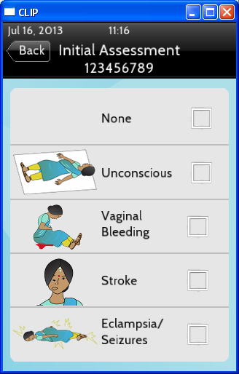
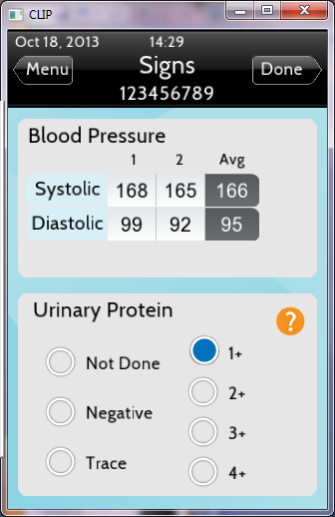
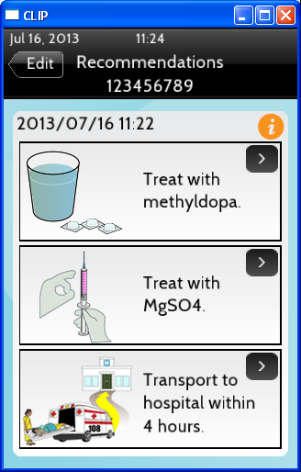
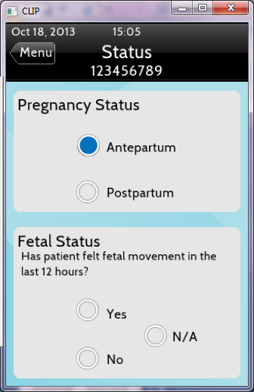
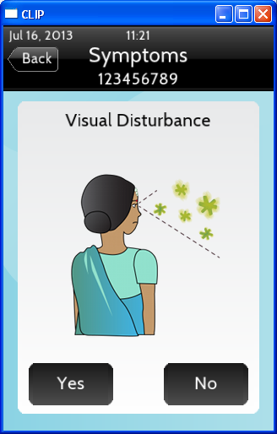
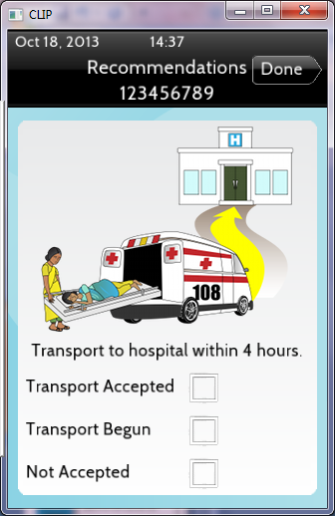
Mhealth
Using mobile technology to support health service delivery
Mobile phones are available, familiar, powerful
Growing evidence for use of apps to support healthy behaviours

Slide 4
Belly breathing
AKA Diaphragmatic breathing
Shown to reduce anxiety
Results in decreased respiratory rate and chemoreflex actuation, increased oxygen saturation and baroreflex sensitivity
Decreased anxiety is associated with decreased stress and pain and more positive experiences of hospital procedures

Slide 5
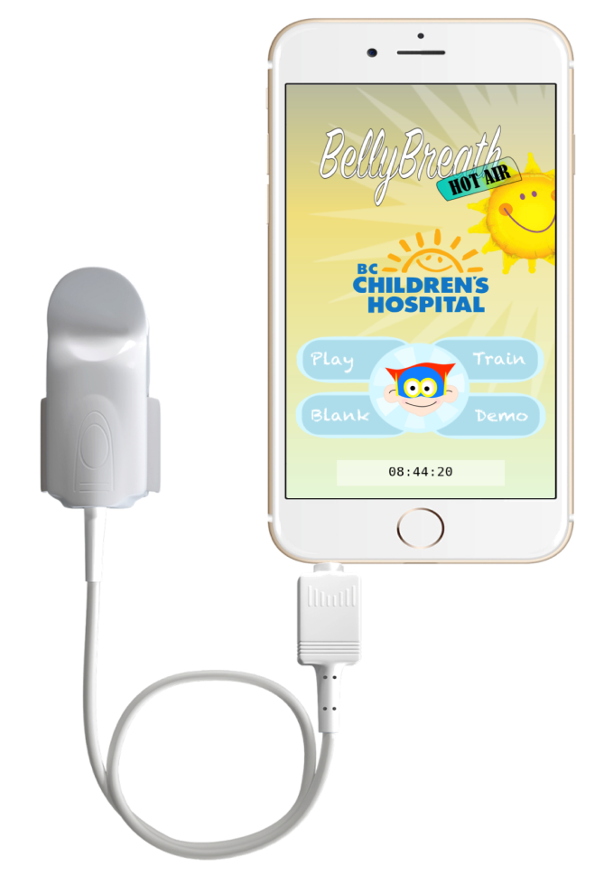
The belly breathing app
Combined biofeedback using pulse oximetry and gaming

Slide 6
Found a significant improvement in kids ability to learn the technique (4x greater)
30% drop in post-procedure anxiety with those using the app

Slide 7
Questions for you!
Do you think this could translate into a tool for pregnancy anxiety management?
What would be the ideal use – antenatal management, postnatal, early labour (think hypnobabies)
Next steps – apply for funding, build a team, feasibility and pilot testing

Slide 8
Thanks!

Slide 9
Our design process
User-centered design
Development of product/software requirements through discussion with implementation partners
Mock-up of tool reviewed by UBC and partner research team leaders and obstetricians
Two rounds of formal think-aloud usability testing with midwives in South Africa (Lim et al. JMIR mHealth, 2015)
Informal end-user testing with community health workers in Nigeria, Pakistan, Mozambique, India
Final design of user interface and training materials based on user feedback

Slide 10
Midwifery in the Press
Jun-Sep/16

Slide 11
http://www.who.int/hrh/nursing_midwifery/global-strategy-midwifery-2016-2020/en/

Slide 12
Summer/16
http://www.ontariomidwives.ca/images/uploads/guidelines/Choice_of_birthplace.pdf

Slide 13
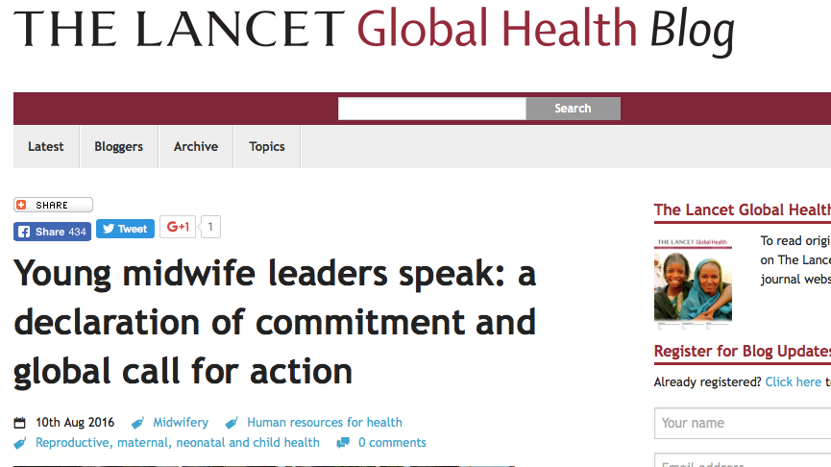
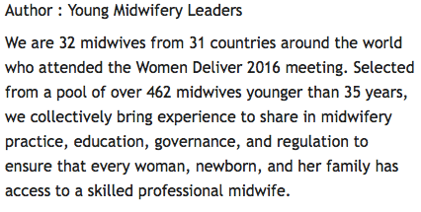
http://globalhealth.thelancet.com/2016/08/10/young-midwife-leaders-speak-declaration-commitment-and-global-call-action

Slide 14
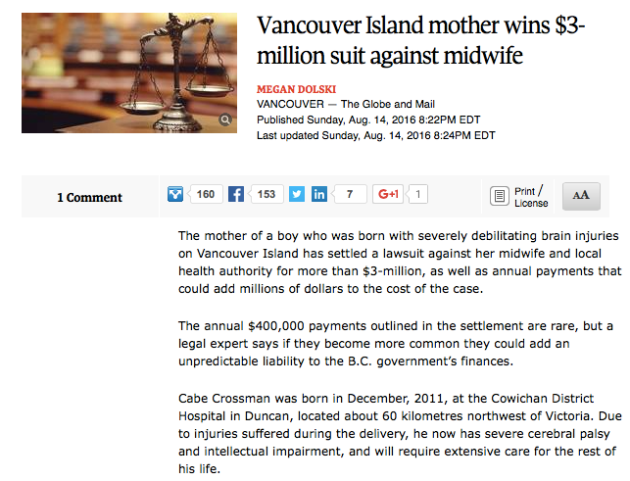
http://www.theglobeandmail.com/news/british-columbia/vancouver-island-mother-wins-3-million-suit-against-midwife/article31403354/

Slide 15
http://thewalrus.ca/still-life/

Slide 16
New NRP Guidelines
Aug 31/16
• Non-vigorous newborns with meconium-stained fluid do not require routine intubation and tracheal suctioning; however, meconium-stained amniotic fluid is a perinatal risk factor that requires presence of one resuscitation team member with full resuscitation skills, including endotracheal intubation.
• Current evidence suggests that cord clamping should be delayed for at least 30 to 60 seconds for most vigorous term and preterm newborns. If placental circulation is not intact, such as after a placental abruption, bleeding placenta prevue, bleeding vasa previa, or cord avulsion, the cord should be clamped immediately after birth. There is insufficient evidence to recommend an approach to cord clamping for newborns who require resuscitation at birth.
https://bookstore.cps.ca/stock/details/textbook-of-neonatal-resuscitation-7th-edition

Slide 17
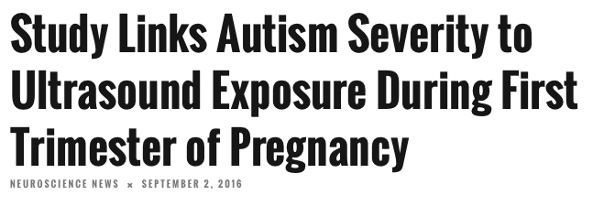
http://neurosciencenews.com/autism-genetics-ultrasound-4956/

Slide 18
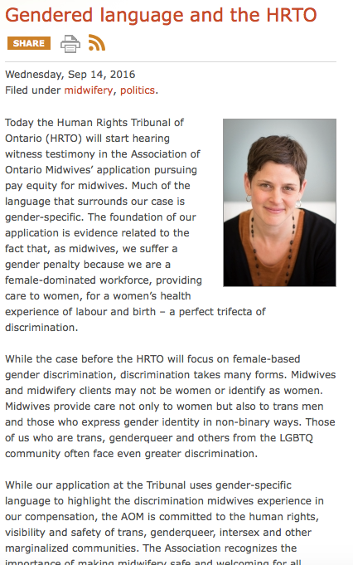
http://www.ontariomidwives.ca/blog/page/gendered-language-and-the-hrto
Sep 14/16

Slide 19
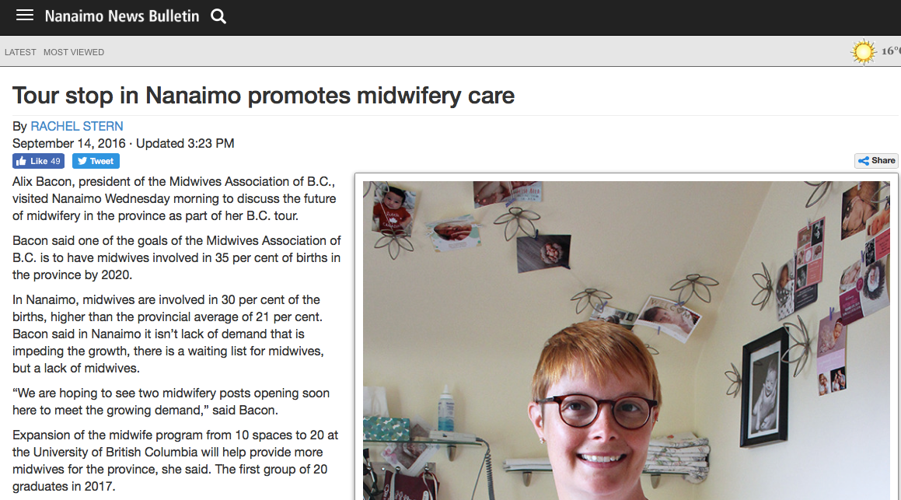
http://www.nanaimobulletin.com/news/392775871.html?mobile=true

Slide 20
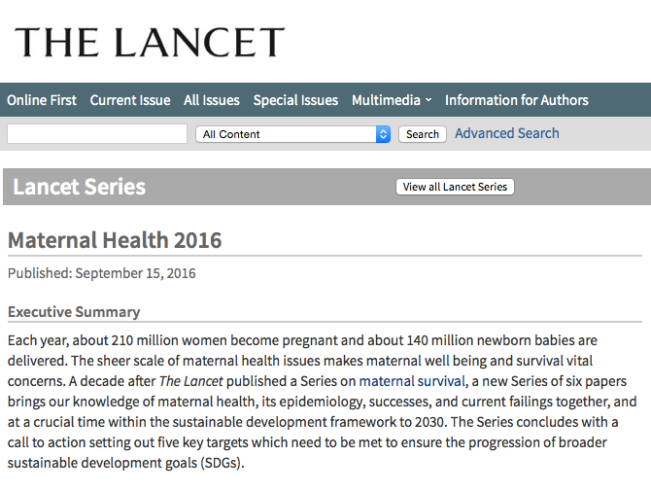
Lancet Series on Maternal Health
http://www.thelancet.com/series/maternal-health-2016

Slide 21
Closing Comments
Lee Yeates

